Slide 1
2024

Slide 2
This year 2,700 young people between the ages of 8-18 took part in Mother Tongue Other Tongue.
Our judges read 250 entries from 38 schools, in 50 languages.
Mother Tongue invites young people to share poems and songs in a language they regard as their mother tongue.
These can be poems that they have found, or that they remember from childhood, or that others have shared with them. Or they can be original and written by the young person in their mother language.
We asked everyone to say something about why they wanted to share their particular poem.

Slide 3
Congratulations to all our Mother Tongue 2024 winners!

Slide 4

Mother Tongue winners this year came from:
All Hallows Catholic College | Altrincham Grammar School for Girls | Archbishop Blanch C of E High School | Bolton School Girls Division
Bridgewater Primary School | Bury Grammar School | Cheadle Hulme High School | Co op Academy Priesthorpe
Dean Trust Ardwick | Didsbury High School | Fairfield High School for Girls | Falinge Park High School
Fallibroome Academy | Lancaster Girls Grammar School | Laurus Cheadle Hulme | London Academy of Excellence
Manor Park School and Nursery | North Halifax Grammar School | Oldham Sixth Form College | Sale Grammar School
St Bernard's Catholic High School | St John Fisher Catholic High | St Monica's RC High School | Weatherhead High School
Whalley Range High School

Slide 5
Winning pieces represented 28 languages…
Albanian | Arabic | Bangla | Bengali | Bulgarian
Chinese-Traditional | Czech | Dutch | Eritrean | Farsi
French | Gujarati | Hindi | Irish | Kurdish
Malayalam | Persian | Polish | Punjabi | Romanian
Somali | Spanish | Tamil | Telugu | Turkish
 | Ukranian | Urdu | Yoruba
Our winners were aged 8-18, we hope you enjoy reading their work as much as we did…

Slide 6
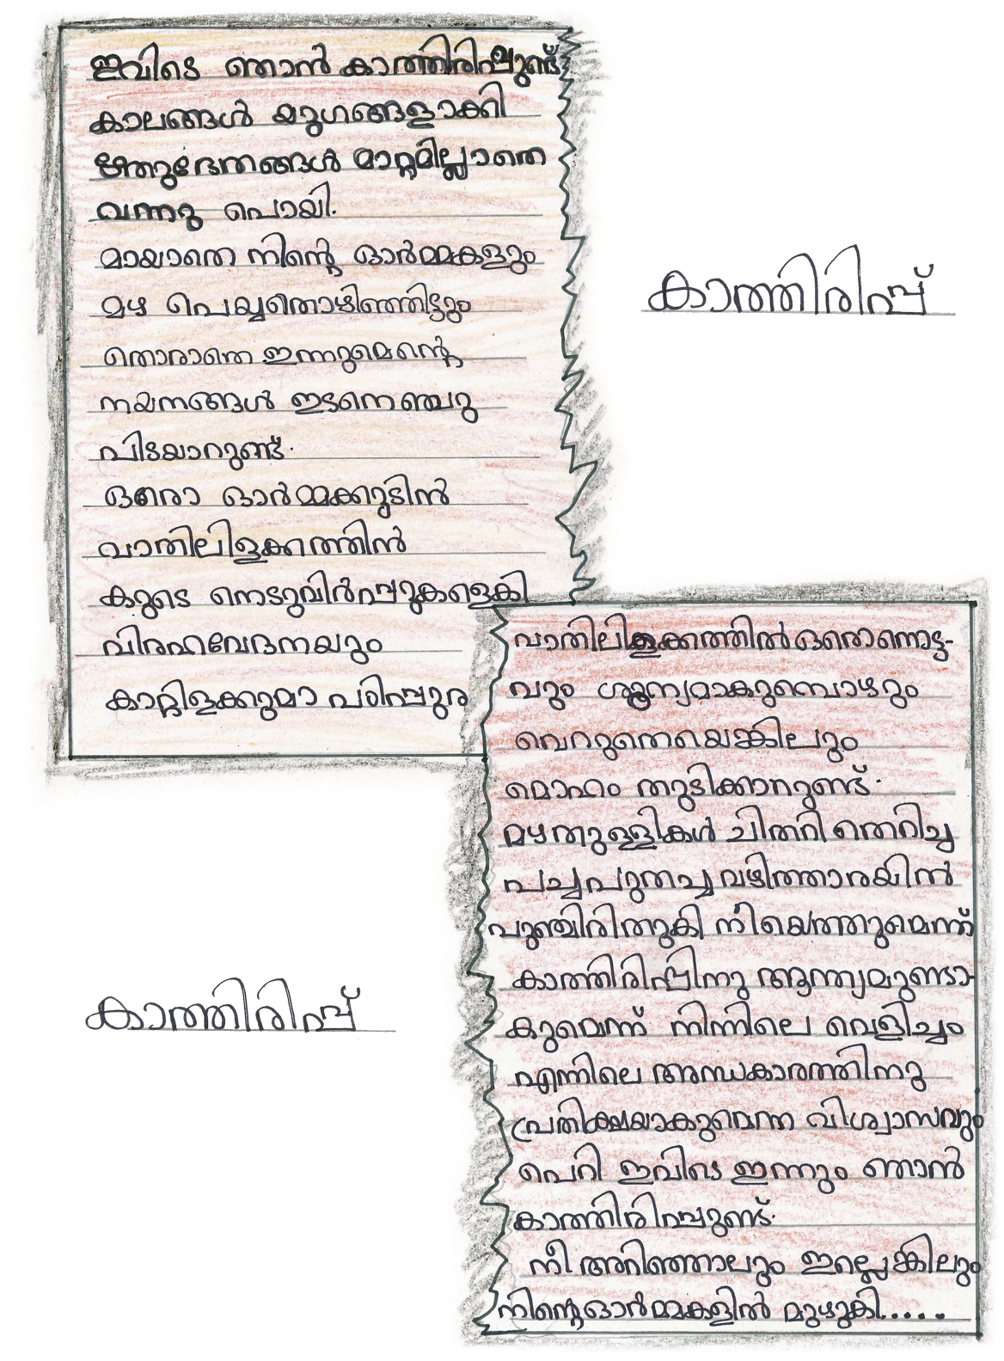
Angelin John (Year 8)
All Hallows Catholic College
I shared the poem ‘Waiting’ because it is my favourite poem in the whole world. This poem is like a part of my life because this is the poem that my grandfather, who died two years ago, taught me when I was in my childhood.
The poem ‘Waiting’ reminds us of the love and care of my grandfather. His presence is like a heaven to me in the same way when I read or write this poem and it feels like my grandfather is standing next to me again.
When I feel this, I feel like I am in a new world, full of hope and peace. In that world, I feel like me and my grandfather are again young with the same love and care that we used to give each other when I was little.
Waiting
By Rabindranath Tagore
(in Malayalam)

Slide 7
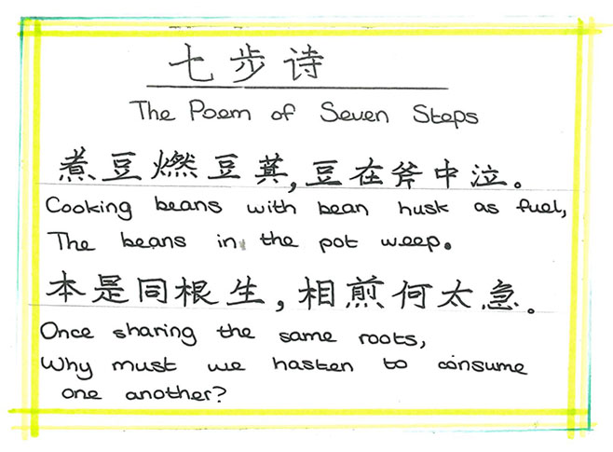
The Poem of Seven Steps
Kitty Yan (Year 8)
All Hallows Catholic College
I chose this poem because it is a perfect argument for why we should take care of our world. We are all related and any damage or disruption to our planet will lead to hurt for us all.
This applies to everything:
Global Warming / Climate Change
Ending Racism / Getting Equality
Deforestation by Large Companies
The poem was written in 430 AD and is still relevant today.
By Cao Zhi (in Traditional Chinese)

Slide 8
Aadya Arya (Year 8)
Altrincham Grammar School
What I lost
I wrote this poem about my identity. ‘What I lost’ represents the hardships I experienced being brought up as Asian-British. I now understand despite being brought up in England my roots, culture and heritage all come from India, and that’s something I’ve learnt to be proud of.
The thing that triggered my confusion was when I’d have to fill out forms; I’d fill out my birthday, gender but when it came to nationality I’d always fumble between Asian and British.
The only way I could describe the feeling was like having a double life. Eventually I was speaking English all the time but my parents would urge me to speak in my mother tongue but to me, English was my mother tongue. So, with time my ability to speak Hindi lessened. I wonder if it was because I was young and couldn’t fathom two languages or whether I was influenced by the environment and people around me.
Over time, I re-learnt Hindi and as of now I can fluently speak it however it’s no longer my mother tongue.
मैं ब्रिटेन में पला-बढ़ा हूं - मैं अंग्रेजी बोलता हूं - मेरे माता-पिता भारत में पले-बढ़े हैं - मैं हिंदी बोलता हूं
मेरी पहचान मिश्रित थी. और इससे मुझे कोई परेशानी नहीं हुई
क्योंकि वे मेरी जड़ें थीं, आपस में जुड़ी हुई थीं
और इसी ने मुझे अनोखा बनाया
मैं अपनी हिंदी लूंगा और उसमें अंग्रेजी मिला दूंगा
मेरे माता-पिता को मैं प्यारा लगता था लेकिन अन्य बच्चे अजीब लगते थे
जैसे-जैसे मेरी जड़ें फैलीं, वे बढ़ती गईं
और जैसे-जैसे सब कुछ बढ़ रहा था, भाषा के बारे में मेरा ज्ञान भी बढ़ रहा था
लेकिन मैं यह अभिशाप नहीं चाहता था जो मुझे उपहार में मिला था
इसलिए मैंने खुद पर बदलाव और झूठी पहचान थोपी
मैंने अपनी मातृभाषा त्याग दी और वह अभी भी वापस नहीं आई है
अतीत में और अब में, मेरी हिंदी पर कालिख पोत दी गई है
मैंने अपनी पहचान खो दी है, और वह मीठा ज़हर अब भी चुभता है
लेकिन इस अहसास के साथ भी मैं गा नहीं पा रहा हूं
उस डंक के बावजूद भी मैं कुछ बोल नहीं पा रहा हूं
क्योंकि जिस जीभ को मैं जानता था वह समाप्त हो गई है और कमजोर हो गई है
मैं अब अपने भीतर की शांति के साथ संवाद करता हूं
और कैद में बेजुबान आवाजों के साथ जिओ
By Aadya Arya (in Hindi)

Slide 9
Tolin Khalil (Year 9)
Archbishop Blanch C of E High School
I am a Kurdish girl from Syria, whose family was forced to flee the country because of the war. My poem is based on my experiences of war and the experiences of other who were living in my country at the time.
The Kurds’ hand symbol is two fingers symbolizing our wanting for peace and independence. I will forever hold my hand as a voice for my community.
I was inspired by a quotation from the UN secretary general called Antonio Guterres:
“They are not just numbers, they are not even refugees, they are mothers, fathers, brothers, sisters, children with the same dreams except a twist of fate has bound their lives.”
Behind Every Tale is a Story
26 melyon li seranserî cîhanê,
Û bi melyonan jî penaberin,
Xewnên piştgirtî ji hêzeke filitî
Ev rewşa vî miletiye.
Berhengarî dijware, di rê de xwe li deryan werdikin,
Hwirdoreke dijmin ne tenduriste,
Mafê mirovên belengaz jê standin,
Ew li hinek aramî digerin.
Di paş her gotinekê de çîrokek heye,
Lehengî,nermî û arîşe,
Ji bo keçeke ji malbatê qetiyayî di rûyê cengê de,
Hejmarên degên nayên bihîstin.
Milet li Başûr ji zordariyê direvin,
Birçî û tî,
Laşî wan di rêde bi gavekê re Jan dide,
Dangê wan nayê bihîstin.
Ew nikanin pîrika xwe di nivînê de hembêzkin,
Hêvî dikin met û xaltiyên xwe dîsa bibînin,
Em bi şans mezin bûne,
Ew hatin paşguhkrin,
Hinekan dilopek av hêvî dikir,
Hinekan jî dilê xwe dixwarin.
Lê di nav bêhêvî yê de,
Her tim hêvî heye,
Deqak ji demeter bê dawî dide,
Ev Kane bibe şans,
Bîranînên xwe rakirn ne we qumê
Li nîşaneke aramî yê digeriyan.
Şûneke ku bi mal re peywendîdarbin,
Şansekî ku karbin hindrî xwe boşbikin,
Li dijî bed kariyê,
Çirkeyek ji dema te,
Bi hev re em kanin guhertinê çêkin.
By Tolin Khalil (in Kurdish)

Slide 10
Menna Almusawi (Year 9)
Archbishop Blanch C of E High School
I am originally from Baghdad in Iraq but currently live in the UK. My parents have always been very keen to speak Arabic to us at home since my sister and I were always mostly surrounded by the English language. Now I can fluently speak the language with my parents and my family members who are still living in Iraq.
I got inspired to write this poem because I want to show how special Iraq is to me. My favourite part of the poem is “From Mousel to Basra cities with their own flair” This line shows how diverse Iraq is with different cities and cultures within the country. Iraq is very special to me because even though I have not visited it recently, I still feel a deep connection to it due to the Arab community in Liverpool and traditions that we have in our family.
Peace Be upon Iraq
سلامًُ على ارض ونهر وهضاب العراق
سلامًُ على اول من اخترع الكتابة في العالم
من الموصل الى البصرة عراق واحد
متعدد الاطياف
سلامًُ على الرجال الصامدين الأقوياء
يبقى صوت الامل بك مدوي ومسموع
سلامًُ على بغداد التي ستبقى محور الحياة
By Menna Almusawi (in Arabic)

Slide 11
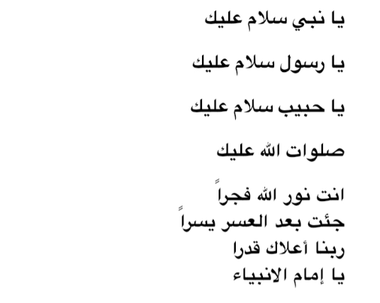
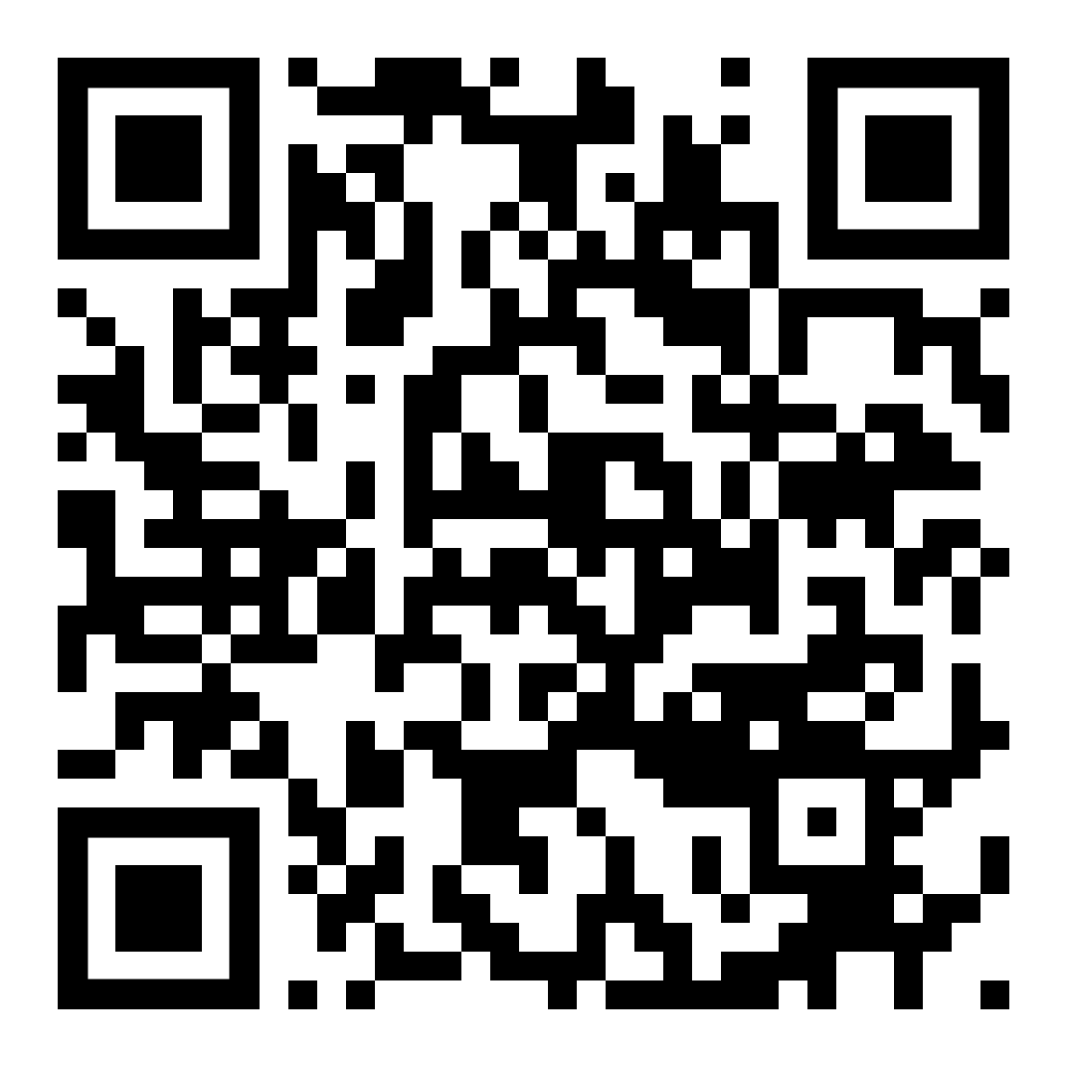
Sama Sahhab (Year 10)
Archbishop Blanch C of E High School
I was born and raised in Liverpool but my roots trace back to Iraq. Growing up in Liverpool with an Iraqi heritage has shaped who I am and how I see the world around me.
My submission is a song by Iraqi singer Kadim Al Sahir and Sarah Brightman. This song focuses on the concept of peace. It’s a touching song which talks about ending conflict and starting something new, with hope and understanding. It reminds us that we need to come together and get along, no matter where we’re from.
On a personal level, this song makes me think about how I want the world to be – a place where people are nice to each other and everyone gets along. It’s inspiring and reminds us that we all play a part in making our world a better place.
Living in a diverse city like Liverpool has exposed me to different cultures, ideas and perspectives, which I believe has enriched my upbringing. Being Iraqi means cherishing my heritage and traditions whilst also embracing the multicultural environment of my home city.
For me, peace isn’t just about not fighting – it’s about making sure everyone feels safe and has a chance to live a good life. When there’s peace, we can focus on things like school, friends, and our futures without worrying about bad stuff happening.
War is Over
Song by Kadim Al Sahir and
Sarah Brightman (in English and Arabic)

Slide 12
Inrah Seedat (Year 7)
Bolton School Girls Division
Mathani Bhet
My mother tongue, Gujarati, holds a special place in my heart. It is more than just a language; it is a connection to my heritage, culture and family roots.
Growing up hearing Gujarati spoken at home became the soundtrack of my childhood, carrying with it a sense of warmth and familiarity. Embracing Gujarati has enriched my identity, promoting a deep appreciation for the tones of its expressions and the richness of its Indian history.
I wrote this poem/song for its simple yet deep depiction of familial love. It tries to capture the essence of the unwavering bond between my parents and my three siblings. The repetition of ‘My mummy, my daddy’ highlights the profound impact of parental love in my life.
It reminds me of the unspoken assurance that, no matter what challenges arise, my parents will always be there for me.
Chand e puchhyu taraone,
Tarao e puchhyu hazarone.
Duniyama sawthi pyaru kon?
Mummy, mari mummy!
Pappa, mara pappa!
Nadi e puchhyu hodi ne,
Hodi e puchhyu mazi ne.
Duniyama sarama saru kon?
Mari mummy, mara pappa!
Mara pappa, mari mummy!
Ghas e puchhyu zaad ne,
Zaad e puchhyu pakshione ne.
Duniyama sarama saru kon?
Mari mummy, mara pappa!
Mara pappa, mari mummy!
Dada e puchhyu dadi ne,
Nana e puchhyu nani ne.
Duniya ma sarama saru kon?
Teo baddhaj mane kahe:
Tari mummy, Tara papa,
Pappa ghusso kare to kyan jaon?
Dodti dodti jaon mummy pase!
Mummy ghusso kare to kyan jaon?
Dodti dodti jaon pappa pase!
Duniyama sara ma sara chhe!
By Inarah Seedat (in Gujarati)

Slide 13
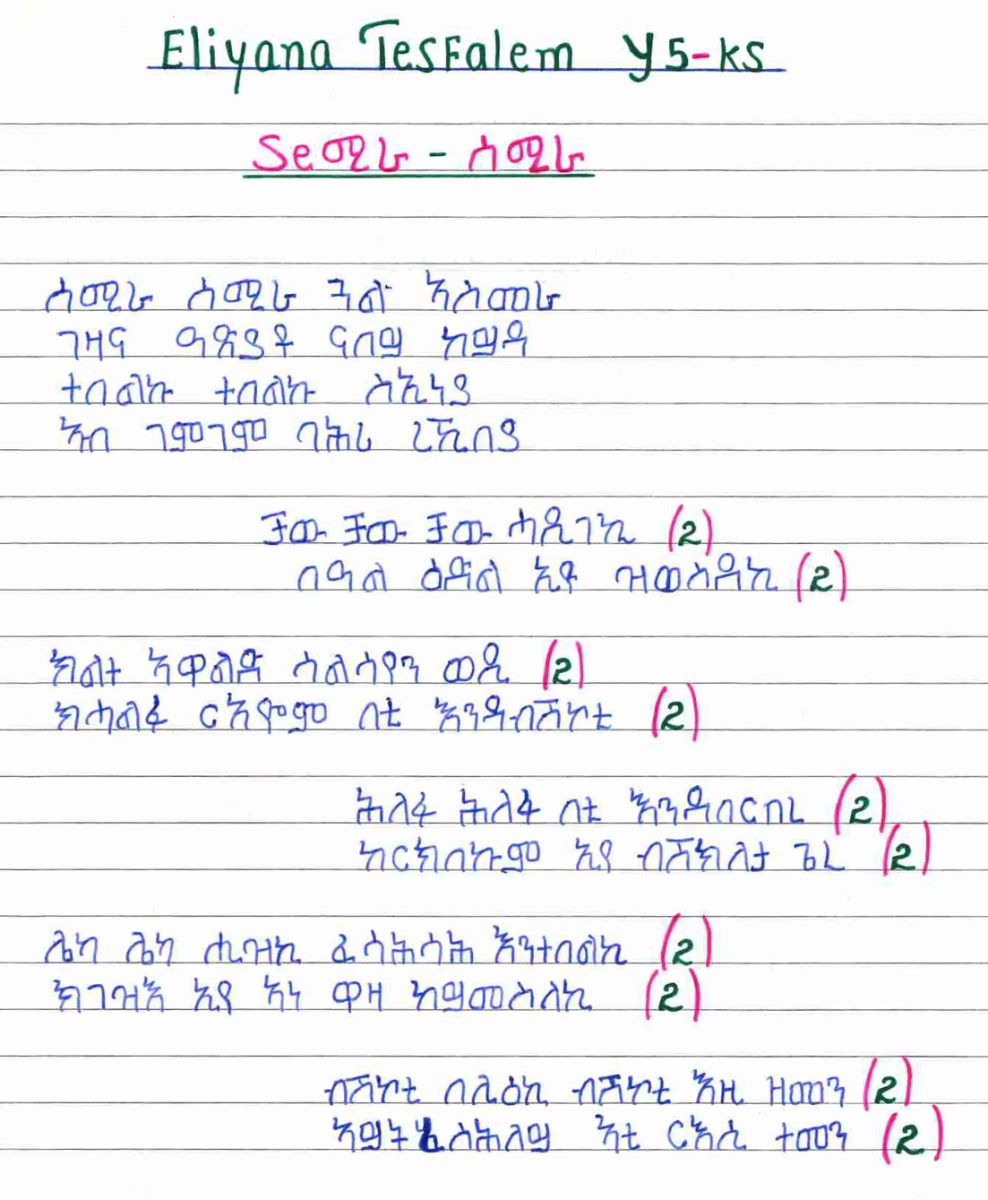
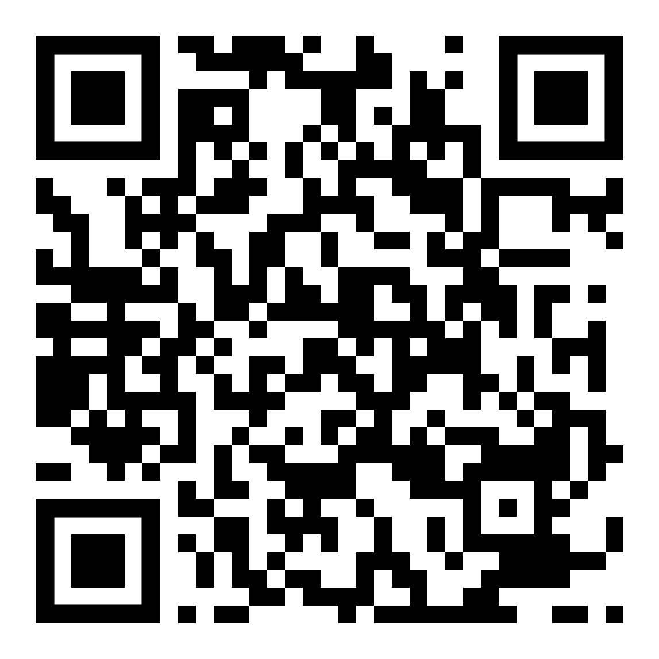
Eliyana Tesfalem (Year 5)
Bridgewater Primary School
This song is very popular in our country, Eritrea. My parents sang it when they were children.
I first heard this song in England when I was four years old and I liked it. Even now, my sisters and I sing it together and we really enjoy it.
Original clapping song in Tigrigna
(in Eritrean)

Slide 14
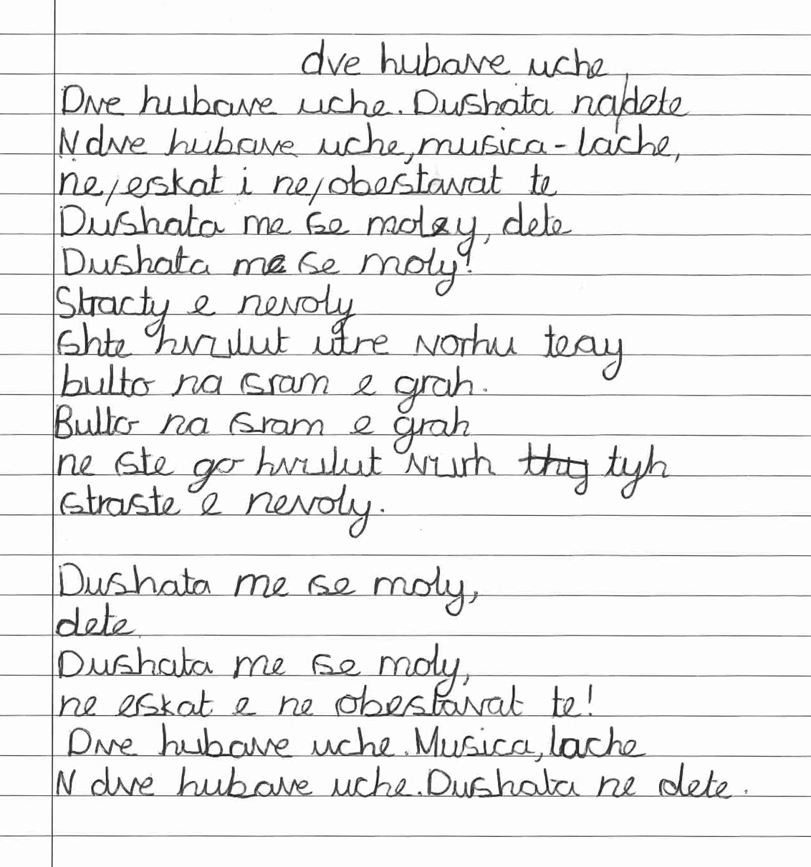
Two Beautiful Eyes
Victoriay Ivanova (Year 5)
Bridgewater Primary School
My mother asked me to write this poem for my family’s country. It is by Peyo Yovorov.
Two Beautiful Eyes is a famous poem in Bulgaria. It is an amazing poem about the soul of a child. My favourite part of this poem is that it starts with pretty eyes and two beautiful eyes. I feel calm describing it.
By Peyo Yavorov (in Bulgarian)

Slide 15
Calista Certan (Year 4)
Bridgewater Primary School
I wanted to write this poem in Romanian for my mum. The title of my poem is ‘Mother’s Heart’ because it is about my mum’s kindness and how she takes care of me and supports me and loves me. I chose to write this because my mum means everything to me and I really love her.
Mother’s Heart
Inima mamei
Eu o iubesc pe mama mea
La fel cum ma iubeste ea.
Mǎ ȋngrijeşte, mǎ ocroteşte,
Cuvinte dulci ȋmi şopteşte.
La ea gǎsesc alinare
Yar ca mulţumire ȋi dau o floare.
By Calista Certain (in Romanian)

Slide 16
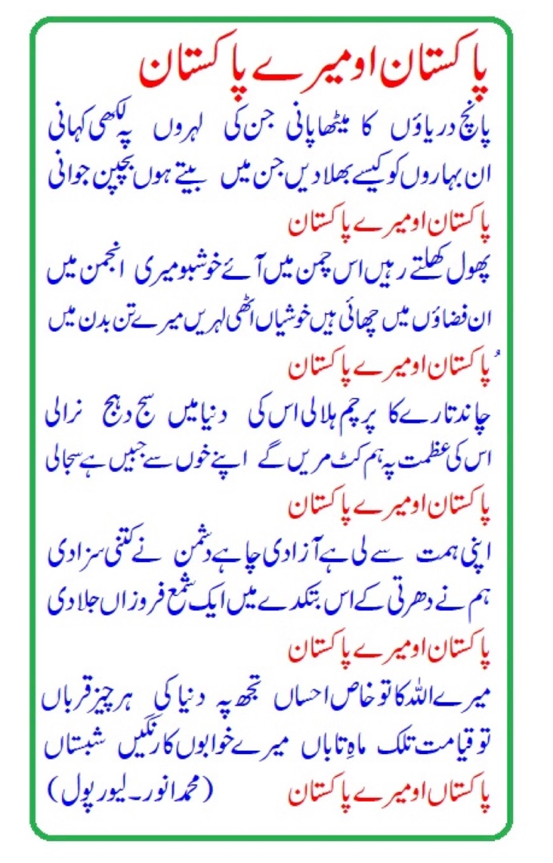
Laaibah Arshad (Year 8)
Pakistan O My Pakistan
Bury Grammar School
My grandpa was an Urdu poet (1970-2021). My native language is Urdu and I grew up listening to and reciting some of his poetry.
My grandpa loved his homeland and would write poetry to express his love. My grandpa was my inspiration and so I chose this poem as it makes me remember my Pakistani roots, though I may live in the UK. I believe that it is important to remember and celebrate your native country and roots. I (just like my grandpa in this poem) refer to Pakistan as my homeland.
This poem is called 'Pakistan o Mera Pakistan'. In English this translates to: 'Pakistan oh my Pakistan’.
In this poem, my grandpa talks about him growing up in Pakistan and reminisces about his experiences while in his homeland. The experiences that he could not find living in the UK. This poem depicts Pakistan as one's home and gives an insight to the younger generations who have never visited Pakistan. It truly reflects the true beauty of my grandpa's homeland that could never be seen living anywhere else.
I like this poem because my grandpa talks about his childhood and there is a clear difference from my childhood (here in the UK) and his (in Pakistan) during the 1940's.
by Mr Mohammed Anwar (in Urdu)
(Founder of the Circle of Literary Friends)

Slide 17
Christmas Traditions
Polina Boichuk (Year 7)
Я дуже люблю зимову пору року.
Коли розпочинається зима я відзначаю своє деньнародження і у нашій сім’й стартує святковий Грудень.
Саме у перший місяць зими у мене і мами і бабусі днвнародженя, а ще багато свят із різними традиціями і обрядами.
Моє найулюбленіше свято це різдво.
Звичайно, що ми стараємося дотримуватися Україньских традицій, але подарунки під ялинкою я також люблю.
Моя мама розповідала як це свято відзначали коли вона була маленька і говорить, що зараз все не так як було.
Але я дуже люблю коли ми їдемо у село Кутище до моєї старенької бабусі Марти, де завжди особлива атмосфера за святковим столом.
Готуєтся 12 різдвяних страв, накриваємо стіл і коли перша зірка появляєтся на небі ми сідаємо вечеряти.
Я люблю слухати як мої рідні розказують про якісь історії зжиття, коли всі сміются, радіють та потім колядують.
Я недуже вмію калядувати, але в нас є спеціальна книга де можна знайти різні тексти колядок.
А потім я біжу до ялинки і починаю відкривати подарунки.
Нажаль, уже 2 рік я не з своїми родичами і цього року відзначатиму Різдво не в Україні, не в Франківську і навіть не у Кутищах, але в англії. Як далеко від дому ми бу усе одно будемо готувати 12 страв як кутю, вареники ,пампухи . А потім будемо колядквати напевне по Viber, але щоб блище разом
Bury Grammar School
My first language growing up was Ukrainian and in the solitude of my thoughts this was my language. Nowadays, my thoughts traverse Ukrainian and English and sometimes I even dream in English. But my bigger dream is not to forget my mother tongue which takes me back to my culture, identity and fond memories of my childhood and my first word ‘baba’ or was it? `
Christmas is a nostalgic time for me and brings back warm memories of happier times steeped in tradition. When I think of Christmas, my mind wanders to family and the times we have spent together. These traditions provide stability for me in an otherwise changing world. Christmas is a time of sharing and giving and I hope I can share our traditions in our new town, yet still look for the first star to appear in the sky knowing that my Ukranian family are looking up too. This is why my poem means more to me now than ever before.
By Polina Bolchuk (in Ukranian)

Slide 18
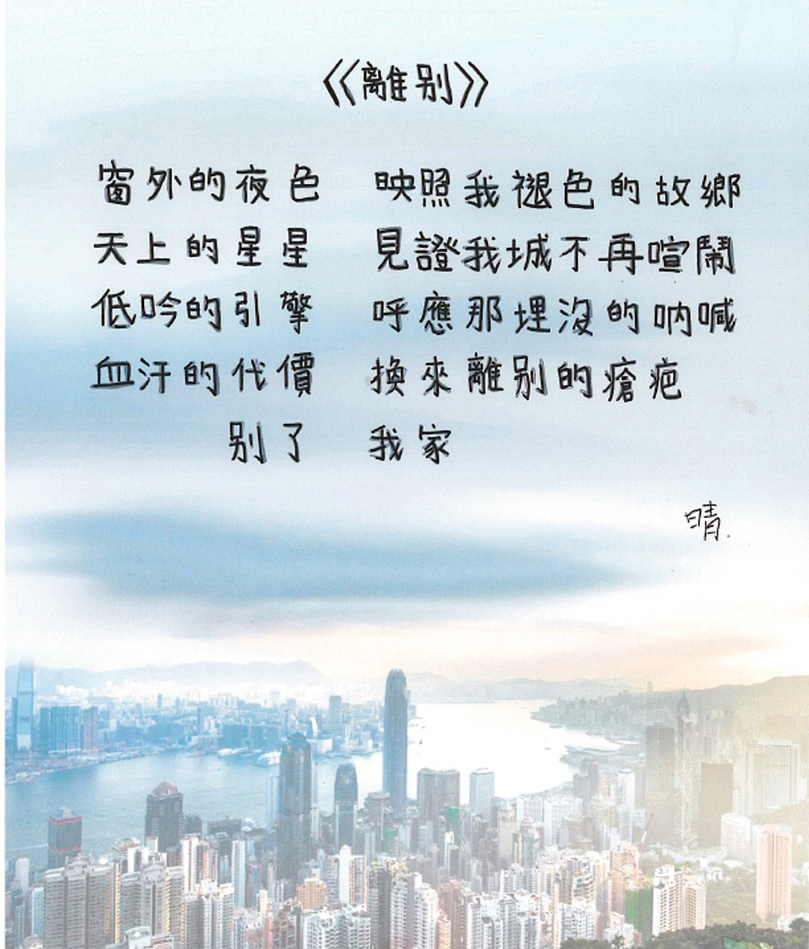
Farewell
Iris Leung (Year 7)
Cheadle Hulme High School
This poem is about my thoughts when I was on the plane, leaving my hometown and coming to England.
The place I was born is no longer prosperous and stable. The blood and sweat of our Hong Kong citizens spent to strive for our rights has eventually led to separation.
By Iris Leung (in Traditional Chinese)

Slide 19

Mother
Charvy Gali (Year 8)
Co-op Academy Priesthorpe
The reason why I chose this poem is because I may not be able to tell my mum how much she means to me. This poem says it all. Even though my words will never do enough in thanking her for the great contribution she made to my life, I want her to know that I am deeply grateful. She has supported me and encouraged me throughout my life. She’s the best among the rest!
No one has a pure heart other than your mother. She believes in you and she’ll always be there for you in your hardest times. She is the only one who understands you and will always believe in you. She must have made a lot of sacrifices for your happiness.
Poem ‘Amma’ by Padeti Johnson (in Telugu)

Slide 20
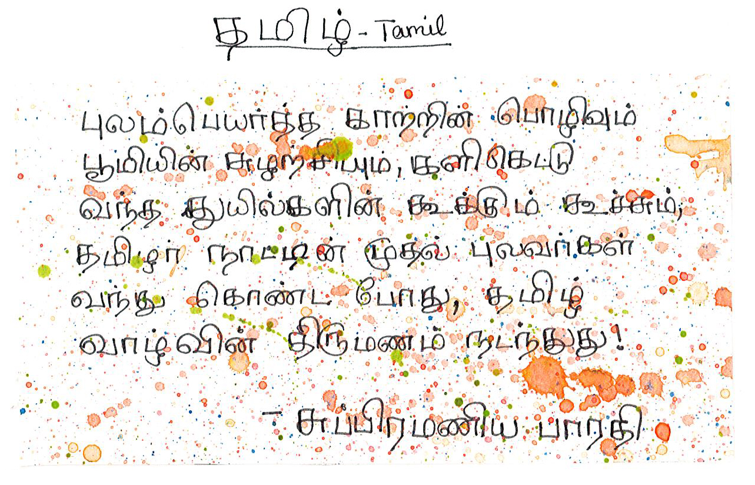
Sahana Jayachandran (Year 10)
Coop Academy Priesthorpe
The poem celebrates Tamil land’s natural beauty and cultural heritage. It describes
“the wind carrying flower fragrances and the earth’s fertility, the cooing and chirping of birds that come fluttering”; symbolising a deep connection with nature.
The arrival of Tamil poets in the line “When the first poets of the Tamil land arrived, the marriage of Tamil life happened” signifies the union of culture and environment, creating a harmonious way of life.
It describes the interconnected hiss of nature, culture and people. This fusion of elements enriches the readers’ appreciations of Tamil tradition. It captures the essence of a thriving, culturally vibrant community, deeply rooted in its natural surroundings.
By Subramaniya Bharathiyar (in Tamil)

Slide 21
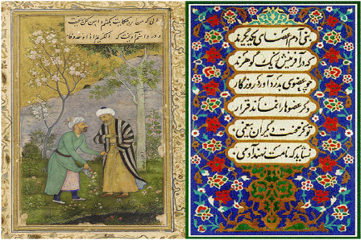
Nastaran Sharifi (Year 10)
Dean Trust Ardwick
The Children of Adam
I am from Afghanistan and I have chosen this poem to represent my identity. The poem says that human beings are connected like the parts of the body and their creation is from one gem. It is also transmitted to other humans. Anyone who is not saddened by the pain and sorrow of others does not deserve to be among human beings.
I think this is a good time to reread this and remember how many people die every day and suffer from the inequality of this cruel world. This is the main reason why I wanted this poem; to remind us of the reality of the living world.
بنی آدم اعضای یکدیگرند
که در آفرينش ز یک گوهرند
چو عضوى به‌درد آورَد روزگار
دگر عضوها را نمانَد قرار
تو کز محنت دیگران بی‌غمی
نشاید که نامت نهند آدمی
By Saadi of Shiraz (in Farsi)

Slide 22

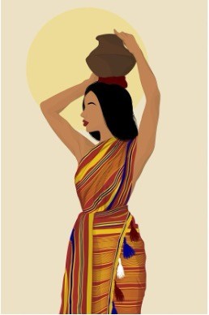
Qaali Daahir (Year 7)
Dean Trust Ardwick
All Somali women are Qaali
I have written this poem to shed light on why my name is a very large and important part of my identity.
A large part of my inspiration to write this poem stems from colonialism and our independence, and the freedom our ancestors have fought for; the same freedom displayed by the women from Somalia.
Qaali means the word high value, expensive and luxurious so to be named after such a prestigious word means a lot to me. I embody being Qaali every single day.
Dhaqanka iyo raaxada,
Magaca Qaali waa naadir.
waan ka mahadcelinayaa magaca la ii bixiyay,
Magaca la ii dhiibay,
Oo waxaan muujinayaa inaan ahay Qaali maalin kasta.
In la xoojiyo xorriyadda loo soo halgamay,
Waxaana laga sheegan jiray beeraha Muqdisho, waa hore.
Xiddigta cadna way ina hagaysaa,
Wax kasta oo naga hadhay.
Xusuus fog oo xanuun badan
Waxa aanu ahaan jirnay
Umad kastaa waxay leedahay calan u gaar ah annaguna waanu leenahay
Muujinaya cirka buluuga ah ee naga sarreeya,
Muujinaya xorriyadda,
Waayo, xor baan nahay.
Qaali’da Soomaaliya ayaa si qurux badan u matasha dalkeena,
Qaali’da Soomaaliya waxay si fiican u matalaan dhaqankeena.
Qaali’-ka Soomaaliya ayaa ka sii daaya in ay ka sarreeyaan.
Qaali’da Soomaaliya, magaca daa’imka ah.
Sida aan u dhigay, way caddahay in la arko.
By Qaali Dahir (in Somali)

Slide 23
Rea Sejdiu (Year 8)
Didsbury High School
I sold them
Vendi ku jetonë rrëenjet e familjes,
Vendi ku gëzojmë kujtimet e verës,
Me fusha të gjelbërta,
Dhe lumenje të pastërt,
Kodra krenare që më duket që me flasin.
Vendi që më jep ngrohtsi të veçant,
Aty dhe ku më pret qeni im I artë.
Shoku im besnik, më jep dashuri pa kushte,
Më zbukuron verën me parqafime e puhtje.
Edhe pse i vjeter, zemera tij është si një qenush i vogël.
Ky është Rocky im, në Kosovën time,
Ku dashuria buron dhe lumturia lulëzon.
This poem is about the nature, mountains, and countryside in Kosovo. Kosovo isn’t as well developed as the UK, but everyone there really appreciates the slower pace of life. The poem follows a street dog who everyone loves & is known by the entire street in my home town of Pristina in Kosovo.
By Rea Sejdiu (in Albanian)

Slide 24
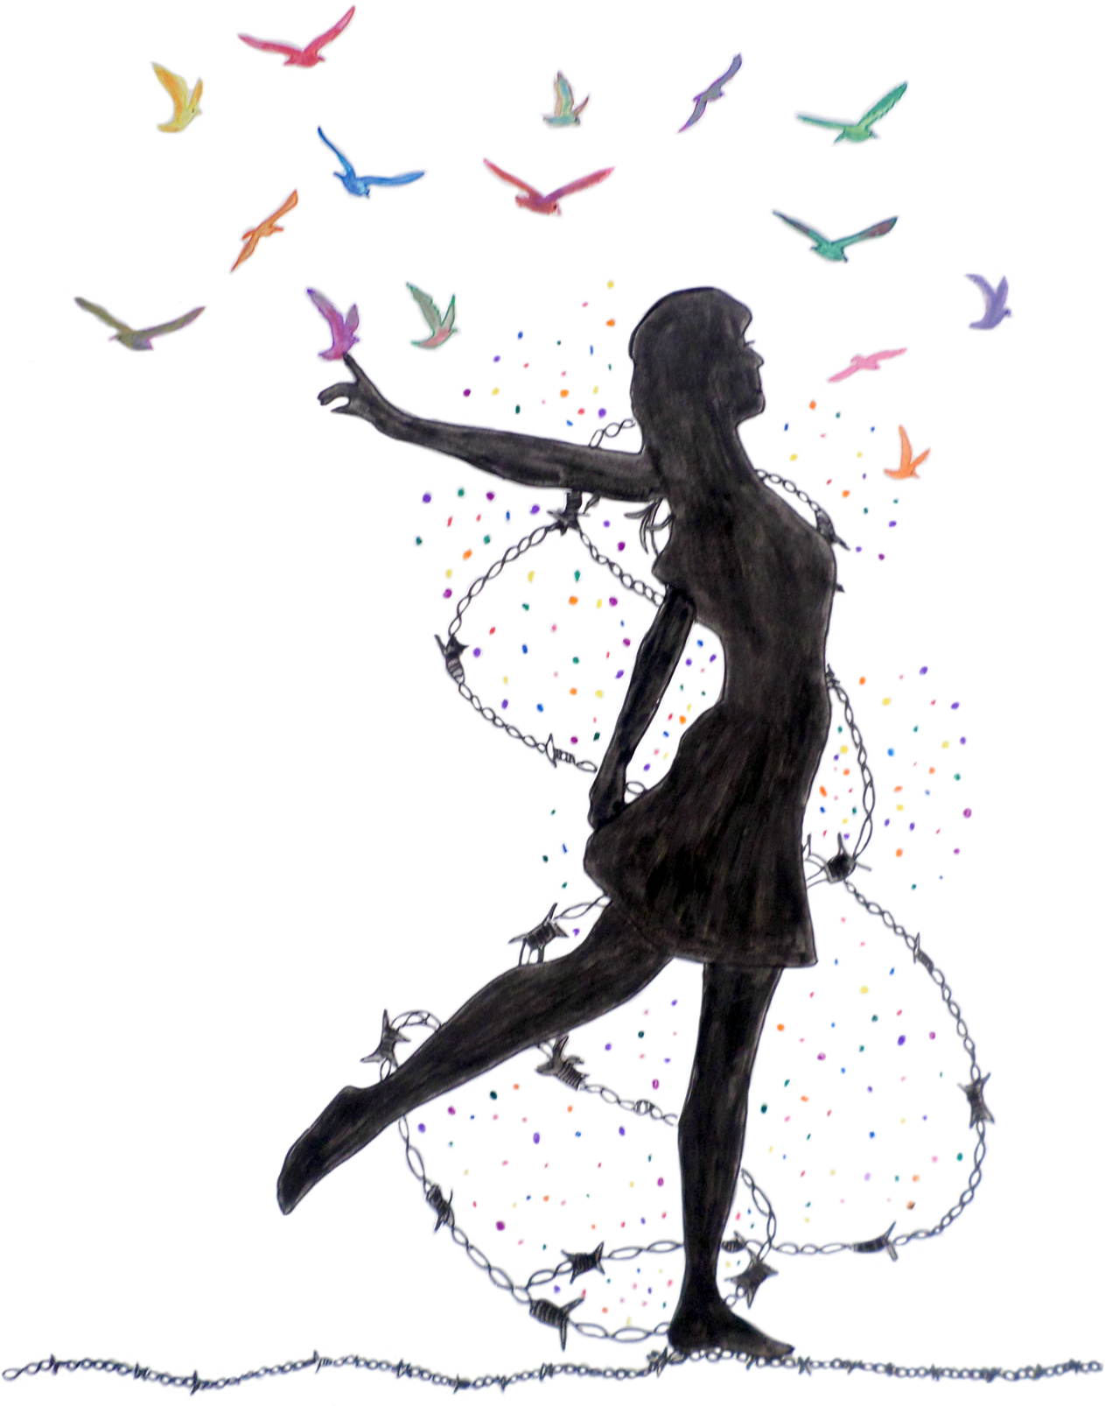
Zainab Hamid (Year 7)
Fairfield High School for Girls
Birds of Happiness
My poem is about the dreams of peace while being rooted down in war and conflict. My artwork represents this through the image of the girl, letting go of the birds. This shows the desire for freedom and how hope is one of the strongest lights. Birds fly without restrictions and there is no limit to how far they can go. The chains are keeping her stuck to the ground, immobilising her, yet they cannot crush her ambition and resilience.
You dream of roses while standing on thorns. We are fed up with these corrupt governments who are only after the gain they can earn for themselves. The people can no longer take it and we will set ourselves free.
Vogels van Vrijheed
In het hart van de chaos, een vloeien van vrede
Een melodie van hoop die nooit zal kreuken
Geen geweld meer, geen haat meer
Gewoon liefde en vriendelijkheid om te veiren
In elke ziel een verlangen naar zachtheid
Om een ​​rustige en heilige plek te vinden
Waar verschillen met liefde en zorg worden omarmd
Eenheid en begrip vult de lucht
Geen wapens mur, geen oorlogen meer
Loten we bouwen aan een werk waarin
Vrijheid heerst. Waar de liefde voor
Altijd zuiver licht blijft
Laten we samen staan, hand in de hand, Een toekomst
creeren die zo groot is
Waar vrede ons volkslied is en leifde onze zweefvliegtuigen
En in harmonisch zullen we altijd blij zijn
By Zainab Hamid (in Dutch)

Slide 25
Saqib Abid (Year 9)
Falinge Park High School
My parents are fluent in Bangla and I am not. I wish I could be but I know it’s not too late to pick it up. I understand the suffering of my ancestors who had to fight to preserve Bangla as a language as part of Bangladesh’s fight for independence in 1971.
I have written this poem to convey the struggles of someone whose parents can only speak a foreign tongue and how they cannot connect to their parents as it causes a barrier between them and their parents and how their mother tongue begins to deteriorate.
“As I am explaining to my mother,
I struggle to articulate my words,
like I’m looking for a needle in a bucket of rice,”
My Mother Finally Understands
আমার ভাষা প্রকাশ পায়,
আমি এটা দেখতে পাচ্ছি,
এর শিকড় আমার শরীর দখল করে এবং এটি আমার ছায়া হয়ে ওঠে,
আমি প্রবাহিত অবস্থায় কথা বলতে শুরু করি,
চিন্তা না করেই,
আমি আমার পাতার অভয়ারণ্যে সম্পূর্ণ এবং স্বাচ্ছন্দ্য বোধ করি,
আমার মা অবশেষে বুঝতে পারে।
By Saqib Abid (in Bangla)

Slide 26
Aleena Afrin (Year 9)
Falinge Park High School
Liberated Soul
All my life I’ve been an outcast
Questioned about my mother tongue
Feeling like a stranger,
To my own country
Don’t know where or when it was freed
Was it 1921 or 1873?
When i am asked about my mother tongue
I stand and stare
Not knowing what to say
Inside I'm feeling bare
Everytime a day goes by
I feel it slowing fading
But whilst i dream
আমি আলোর রশ্মি দেখতে পাচ্ছি
(I see a beam of light)
এর পাশ দিয়ে একটি সুন্দর নদী বয়ে গেছে
(Past it a beautiful river flows)
এটা আমার ভিতরে কিছু জাগ্রত
(Its awakened something inside me)
এমন কিছু যা আমি আগে কখনো অনুভব করিনি
(Something I’ve never felt before)
আমি একজন ভিন্ন ব্যক্তির মত অনুভব করছি
(I feel like a different person)
একজন ব্যক্তি যার ডানা বেড়েছে
(A person who has grown wings)
আগে আমি খাঁচায় আটকে থাকা পাখি ছিলাম
(Before i was a bird trapped in a cage)
এবং এখন আমি একটি মুক্ত আত্মা
(And now i'm a liberated soul)
এবং এখন আমি একটি মুক্ত আত্মা
(Waiting to fulfil a life full of hopes and dreams.)
I wrote this poem to express my journey of identity. Language is what makes me different from everyone else and helps me communicate with members of my family who cannot speak English.
I used to feel like an outcast as I didn’t know my mother tongue as a child. As I grew up I was surrounded by people of different ethnicities and felt embarrassed to speak.
As I grew older I realised the importance of embracing my culture. My mother tongue is my superpower!
By Aleena Afrin (in Bangla)

Slide 27
Toshiba Rennymon (Year 9)
Falinge Park High School
This poem is about my struggles trying to learn my mother tongue, which is Malayalam.
It reflects some of my disapproving family members' attitudes towards my struggle to learn my mother tongue when brought up in an English speaking country.
This also displays my desire to learn my mother tongue as I am trying to celebrate and get closer to my culture as well as get closer to my older family members.
I Have Lost My Tongue
എൻ്റെ കുടുംബവുമായി താരതമ്യപ്പെടുത്തുമ്പോൾ എനിക്ക് അന്യമാണ്
അവർ എന്നോട് ചോദിക്കുന്നു "എന്താണ് തെറ്റ് സംഭവിച്ചത്
ഈ ഭാഷ പഠിക്കാൻ നിങ്ങൾ എങ്ങനെ കഷ്ടപ്പെട്ടു?"
എന്നാൽ അവർ ഒന്നായപ്പോൾ മുതൽ അത് പഠിച്ചു
By Toshiba Rennymon (in Malayalam)

Slide 28
Huma Hussain (Year 9)
Falinge Park High School
A Wildfire
Mother tongue a wildfire sleeping in time
Embers glow, waiting to ignite, so sublime
My Spanish heritage flames, bright and warm
New life to words, an awakening norm,
Rekindled whispers, once lost in the past
Dentro del bosque de versos olvidados, yace
un fuego inactivo, bajo cielos oscuros
frases perdidas anhelan florecer y crecer
Encendido por la herencia, una vez más fluirán.
A medida que la lengua materna surge, un incendio forestall Renacido
This is a poem about how someone's mother tongue got lost. This is a very fundamental part of someone's identity. Through speaking my language, I can communicate with the older generations in my family. Sometimes I feel like an outcast when my family is speaking our home language. I want to be able to embrace it as much as I can.
By Huma Hussain (in English and Spanish)

Slide 29
Marina Tonu (Year 8)
Fallibroome Academy
I am from Moldova and speak Romanian. I moved to England when I was six without knowing English at all.
This poem reminds me of when I was little. I used to love to read out poems and remembered a few by heart. (I have lost this talent.)
One of the poems I loved when I was younger is this one. I would recite it all the time and my parents always proudly filmed me. I still love this poem. It reminds me of home and how far I’ve come in just six years.
Mama
Foicica dulce poama,
Toata lumea are mama:
Mielul, iedul, ursulica,
Puiul cel de randunica...
Fuge noaptea si dispare,
La tot puiul bine-i pare,
Ca din nou e dimineata
Si-si vede maica la fata.
By Grigore Vieru (in Romanian)

Slide 30
Saimah Patel (Year 10)
Lancaster Girls’ Grammar School
Inspiration for this poem stemmed from the sight of the aurora borealis on May 10th, which transitions from Spanish (other tongue) to Gujarati (mother tongue) to convey the speechlessness it prompted. Seeing it at home was mesmerising, leaving me speechless.
The linguistic journey reflects the overwhelming nature of the lights, making it difficult to form words, triggering a return to the native tongue at an attempt to keep going.
The final stanza, entirely in Gujarati containing the same line repeated, emphasizes the profound speechlessness induced by this breathtaking phenomenon.
The Northern Lights
en el manto negro del cielo
Las violetas parpadean y cobran vida
Los verdes pintan un rascacielos
azules bailando como para decir despedida
રંગો નાચે છે, un espectáculo sin fin,
ઘૂમતા અને નૃત્ય કરતા જુઓ, toda la noche sin fin
અંધાર માં ખોયા, en la noche sin fin,
Aurora boreal, ઉત્તર આલોક, siempre sin fin
આકાશમાં આગાળ ઉજાળા, brillan como fuego
અત્યંત અદ્વિતીય, muy única
રંગો નાચે છે સ્વર્ગીય નૃત્ય, espero verlo luego
અત્યંત અદ્વિતીય, muy única
ઉત્તર આલોક, આકાશ પર તેનો આકર્ષક ઘાટો પહેરાય છે।
ઉત્તર આલોક, આકાશ પર તેનો આકર્ષક ઘાટો પહેરાય છે।
Saimah Patel (in Gujarati and Spanish)

Slide 31
Hannah Mintoff (Year 7)
Lancaster Girls’ Grammar School
When I was 4 my babcia (grandmother) and dziadek (grandfather) gave me a book of poems by Jan Brzechwa. A renowned children’s poet. Every night my mum would read me some of these poems however this was my favourite because it reminded me of my Dziadek because he is a hunter and would tell me about his stories in the forest. Jan Brzechwas book was turned into a movie called “Akademia Pana Kleksa” which means “Mr. Kleks' Academy”. It is almost like an old version of Harry Potter. It was made in 1946 and Mr Kleks was a headmaster for a magical academy for wizard.
Wild Boar
Dzik jest dziki, dzik jest zły
Dzik ma bardzo ostre kły.
Kto spotyka w lesie dzika,
Ten na drzewo szybko zmyka.
By Jan Brzechwa (in Polish)

Slide 32
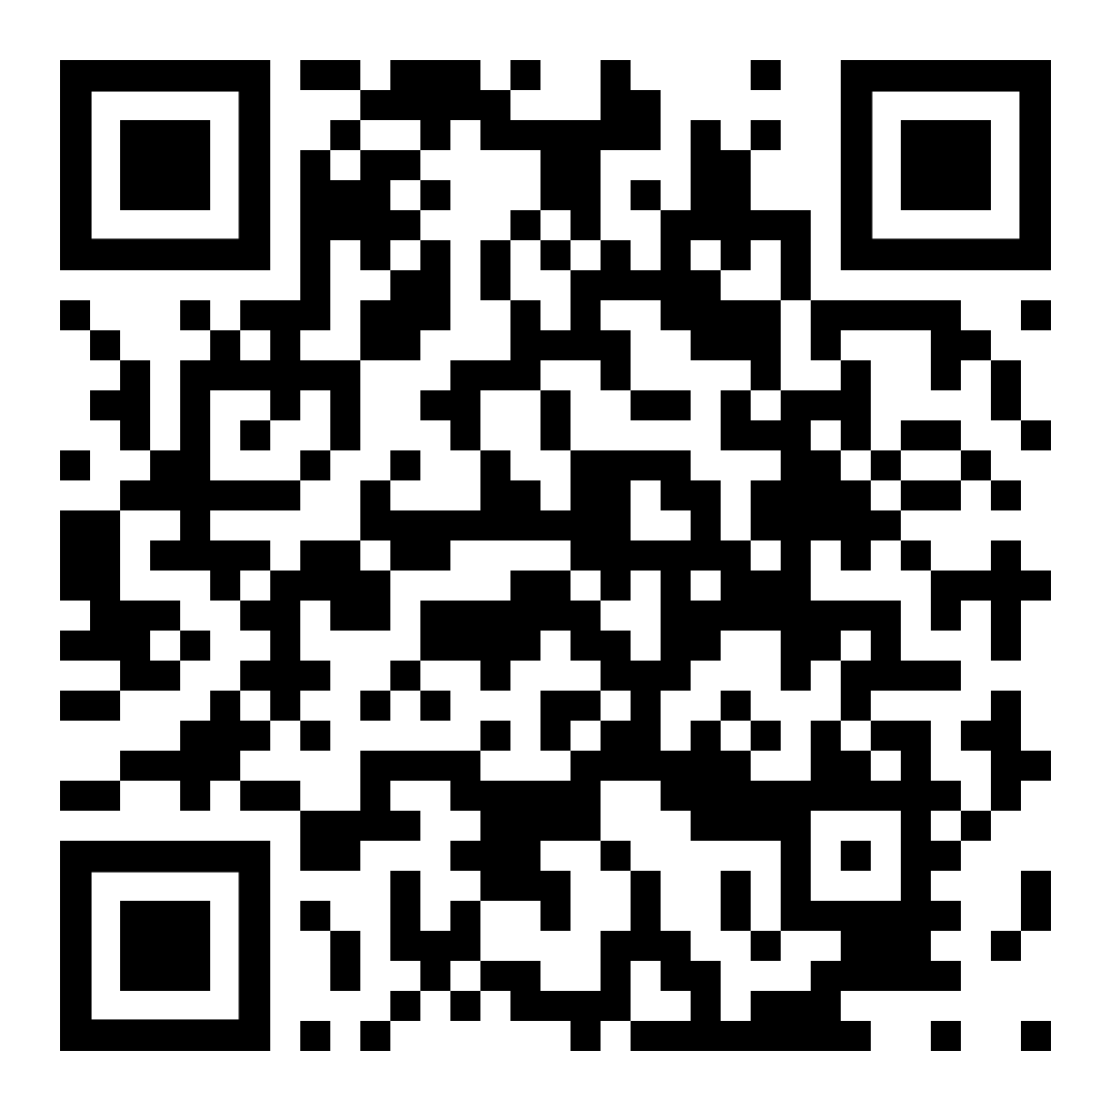
Tynka Zemanová (Year 8)
Laurus Cheadle Hulme
Rosa Na Kolejich
My mum grew up on books by Ernest Thompson Seton, whose books later laid the foundations for a movement called the woodcraft movement, from which grew the Tramping movement. From her childhood, my mum remembers sitting around a fire with others and singing Czech folk songs like ‘Rosa na Kolejich’ and sleeping under the stars. Some of my favourite memories of Czech are going to my great-aunt’s cottage with my family and singing songs while my uncle and grandad played their guitars.
This song is known as the Tramps hymn, a community my mum and grandad grew up in. the song shows a strong yearning for freedom. Tramping played an important role against communism in Czechoslovakia and, although it wasn’t forbidden, tramps were often beaten, equipment taken and later their magazines were made illegal. They were oppressed and their lifestyle controlled … they believed strongly in freedom and were the beginnings of today’s ecological movements.
Tak jako jazyk stále naráží na vylomený zub
Tak se vracím k svýmu nádraží abych šel zas dál
Předemnou stíny se plouží
A nad krajinou krouží
Podivnej pták
Pták nebo mrak
Tak do toho šlápni ať vidíš kousek světa
Vzít do dlaně dálku zase jednou zkus
Telegrafní dráty hrajou ti už léta
Nekonečně dlouhý monotónní blues
Je ráno
Je ráno
Nohama stíráš rosu na kolejích
Aida dobře hlídá pocestný co se nocí toulaj
Co si radši počkaj až se stmí a pak šlapou dál
Po kolejích táhnou bosí
A na špagátku nosí
Celej svůj dům
Deku a rum
Tak do toho šlápni ať vidíš kousek světa
Vzít do dlaně dálku zase jednou zkus
Telegrafní dráty hrajou ti už léta
Nekonečně dlouhý monotónní blues
Je ráno
Je ráno
Nohama stíráš rosu na kolejích
Nohama stíráš rosu na kolejích
A Song by Wabi Daněk (in Czech)

Slide 33
Arwen Amin (Year 13)
London Academy of Excellence Tottenham
Whenever I speak Gujarati or Irish to my family they instantly light up. It's another way to communicate which makes us closer, as I am included in something which is native to them.
I wrote this poem to display both my Indian and Irish heritage as a connected rather than conflicted part of me. Biryani was a dish that Baba (my paternal grandmother) would sometimes make, and the first quotation is part of her mantra—which was also played at her funeral. Whenever I see these words I am reminded of how much I appreciate and love her.
The second tercet also shows how food has connected me to my culture, as brown stew is a dish which my Granny (my maternal grandmother) makes whenever we visit her in Ireland. Thinking about it always makes me incredibly nostalgic.
Originally
The soft scent of biryani and the tapping of a ladle,
the mutter of my Baba as she recites her morning prayers,
‘Om bhur bhuva suvah,’ she says.
The warmth of brown stew as it’s wafting through my body,
the humming of my Granny as she makes her way upstairs,
‘Tá an lá go hálainn,’ she says.
The pitter of the rain as I lull myself to sleep,
and I reach for such memories again.
By Arwen Amin (in English, Gujarati and Irish)

Slide 34
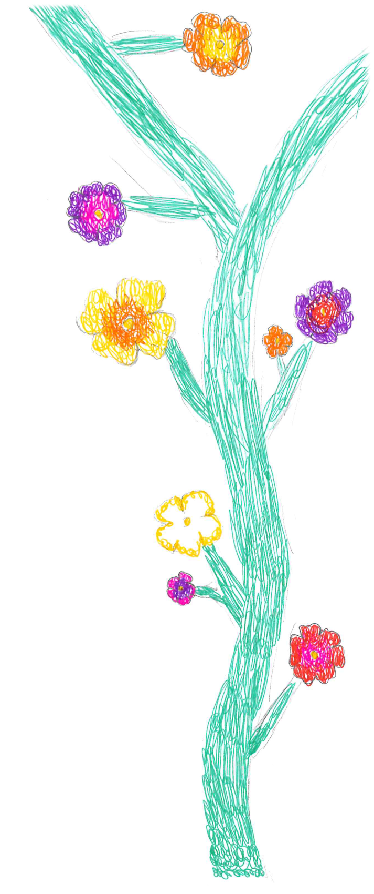
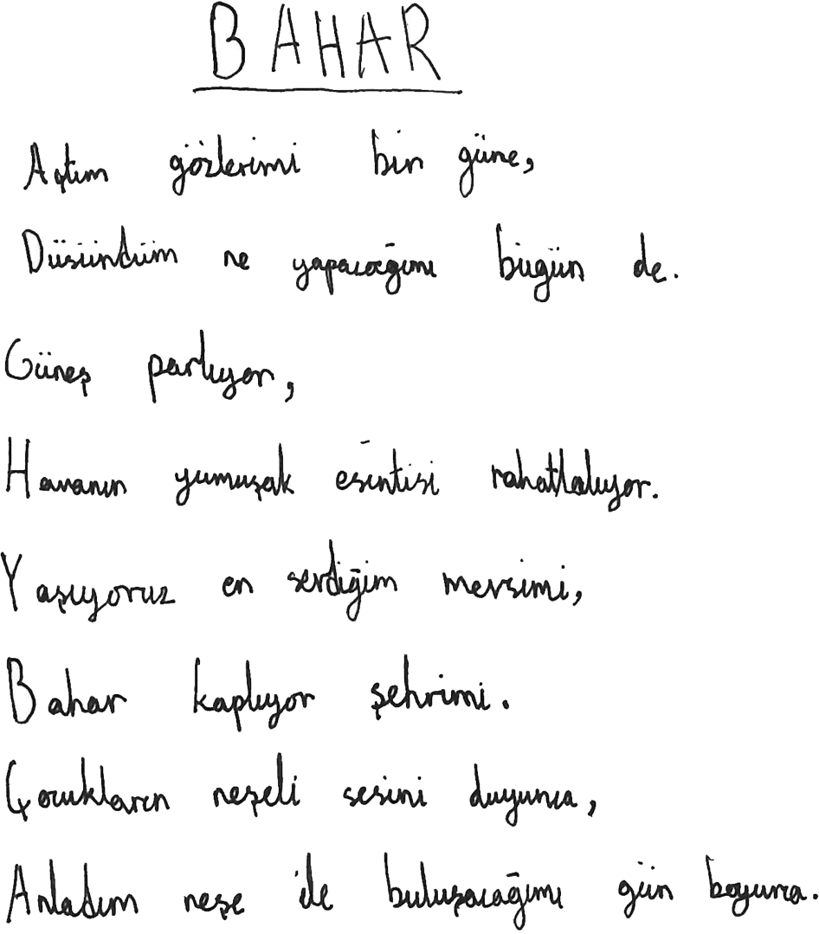
Elif Zehra Iris (Year 6)
Manor Park School and Nursery
I chose to write my poem about Spring because it reminds me of the good days I had in Turkey. It helps me to feel the warm, perfect Spring I witnessed in my home country.
I used to play with my friends in the friendly breeze, with the birds singing a soft tune. This poem reminds me of when I was little.
By Elif Zehra Iris (in Turkish)

Slide 35
Luca Mullaney (Year 7)
North Halifax Grammar School
Ти знаєш, що ти — людина (You know that you are human)
I have been learning about this poem at Ukrainian School and I thought it would be a nice one to share. The poem is called 'You know that you are human' by a Ukrainian poet called Vasyl Symonenko. Symonenko is a famous poet in Ukraine and his poems are still very much alive in the country today and inspire Ukrainian people at a time when they need it the most.
The poem talks about the idea that everyone on this earth is unique. In his words he reminds us all that life is short and we must live for today and enjoy life. Every life counts. Symonenko speaks directly to the reader and uses repetition to emphasise the point that we are all special in our own ways.
Ти знаєш, що ти — людина.
Ти знаєш про це чи ні?
Усмішка твоя — єдина,
Мука твоя — єдина,
Очі твої — одні.
Більше тебе не буде.
Завтра на цій землі
Інші ходитимуть люди,
Інші кохатимуть люди —
Добрі, ласкаві й злі.
Сьогодні усе для тебе —
Озера, гаї, степи.
І жити спішити треба,
Кохати спішити треба —
Гляди ж не проспи!
Бо ти на землі — людина,
І хочеш того чи ні —
Усмішка твоя — єдина,
Мука твоя — єдина,
Очі твої — одні.
By Василь Симоненко (Vasyl Symonenko) (1935-1963) (in Ukranian)

Slide 36
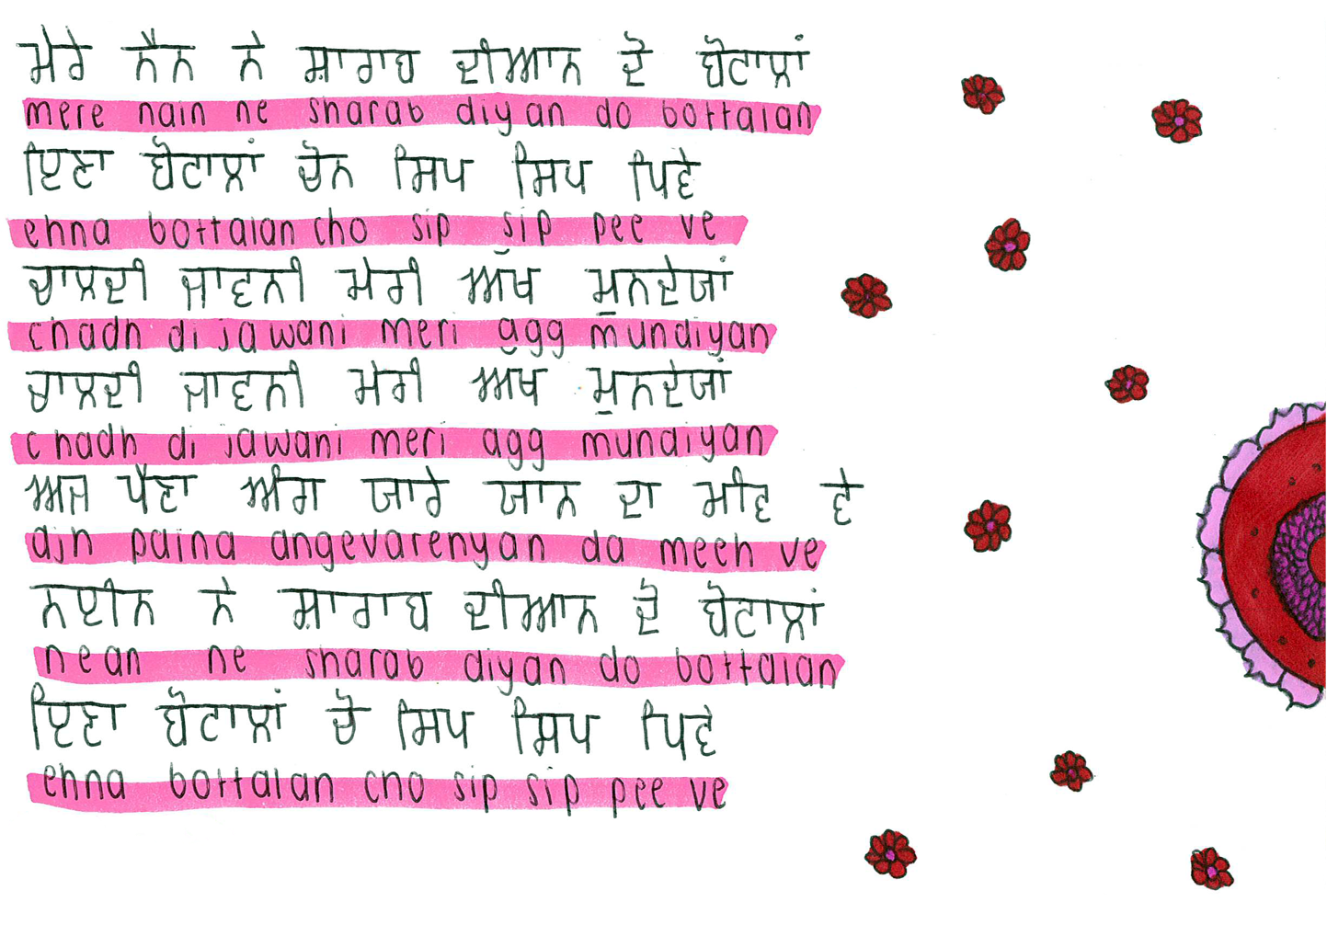
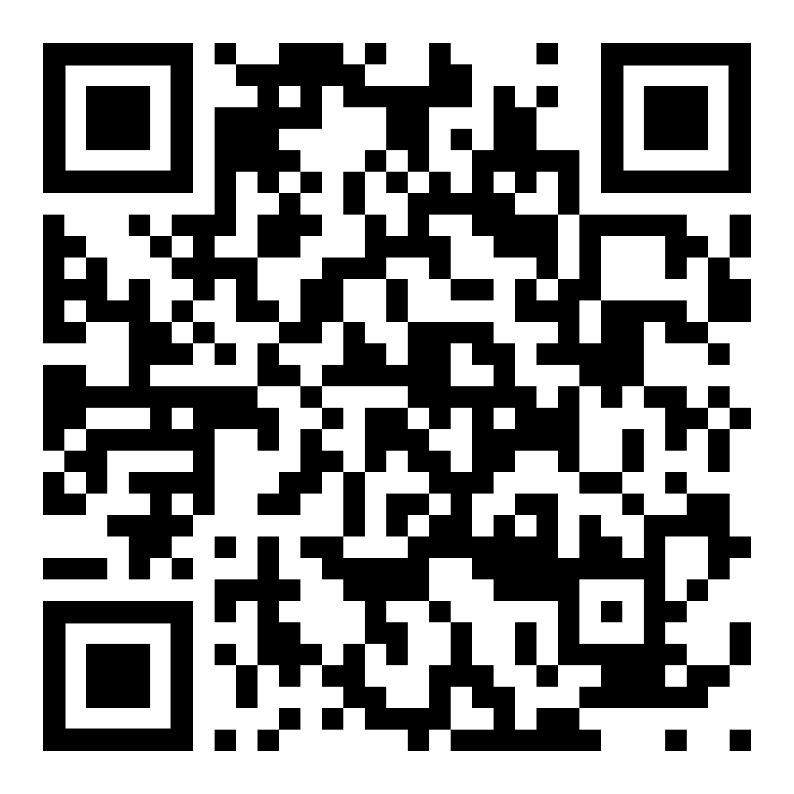
Sip Sip
Suriya Bagri (Year 10)
North Halifax Grammar School
Living 4000 miles away from Punjab, where my heritage lies, I was never interested in Punjabi culture growing up. Until I found a passion for Punjabi music. Through the music, I found my identity and have been fascinated with the culture ever since.
When I was eight years old, at a wedding, I first discovered this song and saw the true happiness that it brought to others listening to it. It was truly in this moment, six years ago, that I fell in love with my culture and rediscovered my identity.
Although it meant little to me in that moment, it was through that very song my roots were dug up. That is the reason why I chose to share this song. It shows that a simple string of words put together can change and transform people’s lives, everyday.
A song by Jasmine Sandlas (in Punjabi)

Slide 37
Sibbir Salehin (Year 13)
Oldham Sixth Form College
I grew up in Barcelona in the Raval neighborhood, a neighborhood where there have always been many social problems such as drug sales, evictions, problems in the streets, etc.
This poem explains what it is like for a new person seeing the neighborhood for the first time, where many good and bad things happen at the same time: art in the streets, robberies, a beautiful building, a fight.
I was inspired when a friend from high school who was from a wealthier family and had never visited the neighborhood came to visit me. He explained why this place is so unusual and the stereotypes he had about a slum neighborhood. He talked about how he has gone through feelings like insecurity, fear, etc. when he came to my house. This amazed me, because in my eyes my neighborhood is different.
That day I convinced him to go out and explore and I told him many stories about the neighborhood and the good things. Since that day he has come to my house without any fear.
El Raval
Bajo el manto de la noche, sus calles susurran cuentos,
donde el arte y el lío son eternos asientos
En el Raval de Barcelona, donde la mente se desnuda,
se ocultan sus secretos en cada esquina muda.
Entre luces y sombras, se teje su enigma sutil,
un barrio de contrastes, de pasiones en exilio.
.
El Raval, doble sentido, en cada verso se esconde,
un poema inacabado, un problema que responde.
Así, el Raval de Barcelona, en sus dos personalidades
esconde mil historias en sus estrechas calles.
By Sibbir Selehin (in Spanish)

Slide 38

Katechizm
Zuzanna Dawidziuk (Year 7)
Sale Grammar School
This poem, written by Wtadystaw Betza, has a few titles, like ‘Wyznanie Wiary Dzieciecia’ (Confessions of faith of a Polish Child.) It was published in 1900, when Poland was deprived of its independence. During this time, proper education for children was even more important than today.
Only instilling patriotic values in subsequent generations allowed Polish identity to survive. For this reason, poets created simple, accessible poems that made it easier to learn national signs and symbols.
This poem has a call and response structure. The child’s answers are fairly simple, but they contain the essence of Polish national identity.
By Wtadystaw Betza (in Polish)

Slide 39
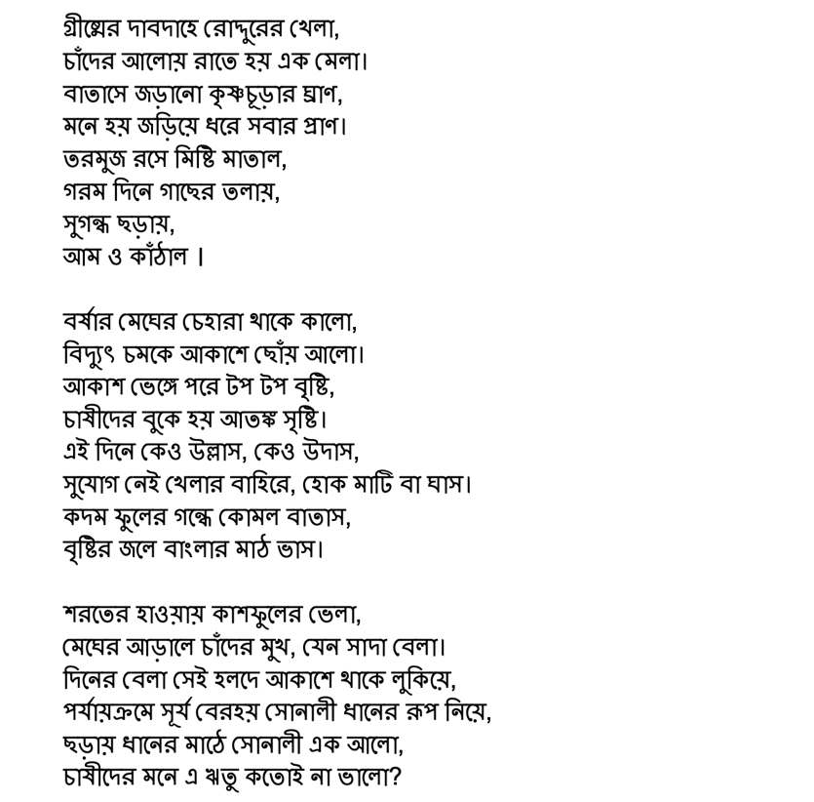
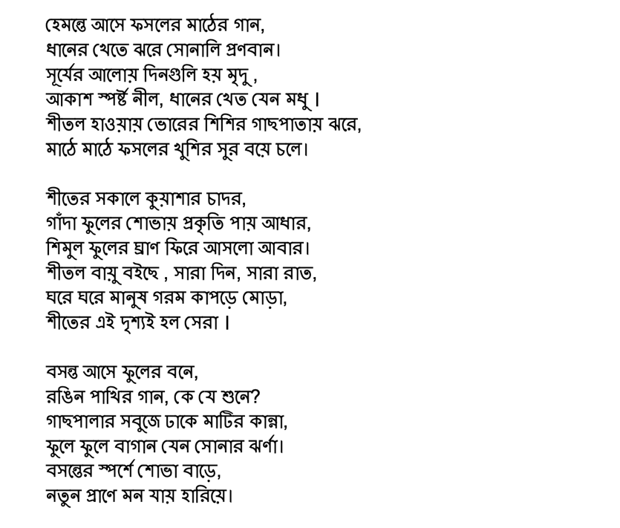
বাংলার ঋতু (Seasons of Bengal)
Al Ayman Sarker (Year 9)
St Bernard’s Catholic High School
It has been well over three years since I last experienced the weather of Bangladeshi seasons, and due to Covid, it’s been four years since I truly enjoyed them outdoors.
This poem is an original account produced from fragments of my memory, attempting to recreate what it feels like to be present in each season in the Land of Six Seasons.
Drawing from the experiences of distant farmers I read about as a child, and what I personally saw, smelt, and felt, the aim was to express the environment and emotions of living through these seasons in a poetic fashion.
By Al Ayman Sarker (in Bengali)

Slide 40
Ireoluwa Adeyeye (Year 9)
St Bernard’s Catholic High School
I wrote this poem in reference to experiencing a different life when I moved from Nigeria to England a few years ago. The social problems in the world such as inequality, corruption and racism are much more evident here than in my own native country.
We must all endeavour to make the world a fairer place by ending our hatred and disrespectful attitude towards each other as, like I said at the end of my poem, life is worth living for.
I’m Sorry Little One
Ma binu kekere
Ma binu pe won mu o
Wa sinu aye aiya yi.
Aye ibi ti awon okurin
Tiw a ni yin fun jije a
Obinrin ni a
Npe ni asewo.
Aye kan nibiti elyameyo
Tun dabi eni pe onyo kuro
Ni ipase paapaa lehin awon
Ewadun ti ehonu – Irora
Akon ni asan.
Ma binu pe awon asnaju
Iran yii ti fa ibaje iori
Iran ti mbo.
Ma binu pe oni kati rir
Otiti lile ti adbaye wa.
Aye kan ti a baje
Pupo lati moa won
Asise tire
Aye kan nibiti awujo
Ti dojuko ohun ti ko
To nigba ti awon ise
Alaim o ti n sele ni
Oju ti o han gbangba
Bawo ni a se baje.
Ma binu, a binu, se won binu
Aye ni to ngbe
O kun fun awon oke
Ati isale.
Frows adi ops sugbon
O ko mo ohun ti yoo sele
Ni ola.
By Ireoluwa Adeyeye (in Yoruba)

Slide 41
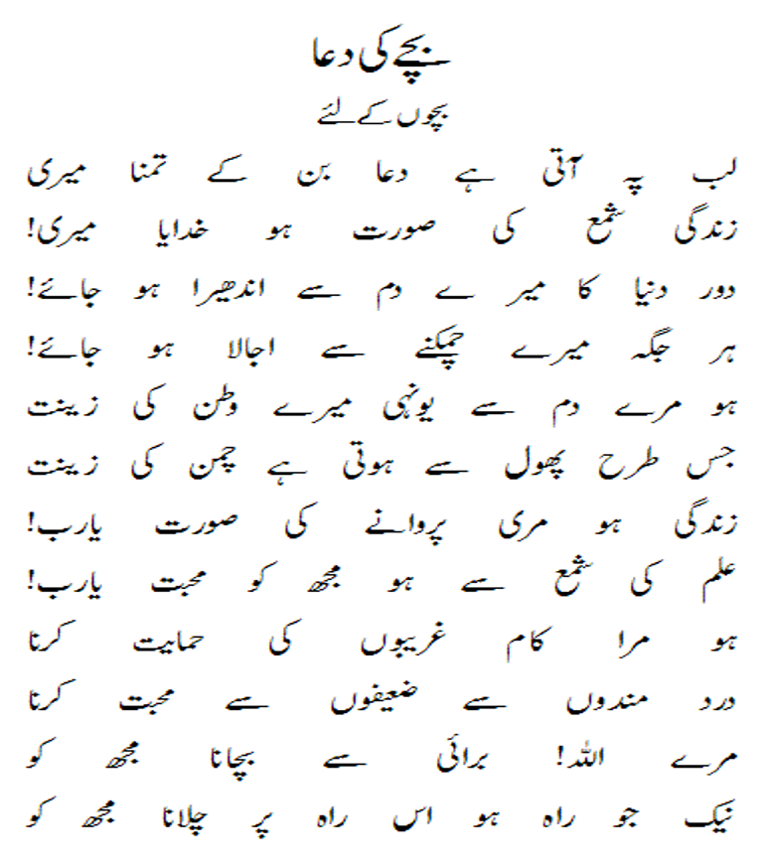
Emaan Baloch (Year 11)
Mother
St John Fisher Catholic High School
Munawwar Rana, the esteemed Urdu poet and author’s contribution to Urdu literature is his poem ‘Maa’, which beautifully encapsulates the profound essence of a mother’s love.
This poem starts off with telling how a mother’s love is unending and she will stand with and for you in your darkest and hardest moments of your life. So never break her heart with your words or actions. Your mother is like a shadow which follows you and protects you.
This poem reminds me of my mum and how much she does for us. She works hard to take care of us and teaches us the values of society we need to know. She also teaches me and my sibling about our Pakistani traditions and culture. And she makes delicious food.
By Munawwar Rana (in Urdu)

Slide 42
Johan Abreu (Year 7)
St Monica’s RC High School
Spanish is special to me because I have been speaking and hearing that language my whole life and it is a big part of me and my personality. It is the language I first wrote in and it is the language I first read in.
This poem means that I cannot use my mother tongue even though I have been using it my whole life. This is important to me because it is the language I have been speaking since I was 2 and it is hard not to forget it.
Mother Tongue
Sin mi lengua soy nada
Intento no olvidarla
Pero eso es imposible
Es como tener algo que no puedes usar
Es como tener amigos a los que no puedes ver,
Es como tener una mitad inútil
By Johan Abreu (in Spanish)

Slide 43
Isabelle Manoj (Year 7)
St Monica’s RC High School
Home is Home
I have written my poem in English, Hindi and Malayalam. These languages represent my culture and how I speak with my family at home. It is amazing knowing that I can spend time at home speaking different languages with my family.
This poem is about how home feels like to me and how life feels like at home spending time with my family every day. Home is an amazing place to me and I am very grateful that I have an amazing place to live.
Veet oru pratheyka lakshury pole kaanappedunnu
Oru surakshit sthalam
Mikacha ormmakal srishtikkanulla oru sthalam
Veet shaanthamaaya sthalam pole thonnunnu
Tvyil oru sho
Janaliloode oru kaattu
Ammamar kari paakam cheyyunnathibte manamaanu veedinu puthiya chedikalude kalam
Puthiya bekking
Veet oru comfurthe son pole thonnunnu
Shaaswathamaaya oru sthalam
Njangal ulppeduna oru sthalam
Veet veedaanu
By Isabelle Manoj (in Malayalam, English and Hindi)

Slide 44
Do you understand me?
Do you understand me?
As I’m on the phone to my mum
Stringing unusual sounding sentences together.
Another word for home, another word for school
Different to what I’d say if in conversation with you.
Do you understand me?
And the casual switch in my brain
As I step into my house
And my thoughts and the words from my tongue metamorphose
From English prose to Polish verse?
Do you understand me?
And the validation I feel
As I’m applauded
For this distinctive ability to speak.
“You speak another language? That’s so cool!”
It’s cool, until it’s not.
Quite often I wonder…
…if you understand me?
I tak jak się czułam kiedy miałam 6 lat (And the way I felt, aged 6.)
Siedząc cicho w klasie angielskiego (Sitting silently in an English classroom,)
Pozbawiona dźwięku tego co wydawało mi się domem (Stripped of the sound of what feels to me like home)
If you understand me?
Kiedy zwykła reklama w moim telewizorze (When a simple advert on my TV)
Sprawia że tęsknie za swiatem ktory opuściłam 9 lat temu (Makes me miss a world I left 9 years ago)
I za słowami które kiedyś rozlałam po jego ulicach. (And the words I once spilled over its streets.)
If you understand me?
Kiedy mówię że chcę iść do domu (When I say I want to go home)
I nie mam na myśli cegieł oddalonych o pięć minut spacerem (And don’t mean the bricks a 5 minute walk away)
Ale do lądu do którego dotrę tylko przez 2 godziny w samolocie (But a land I’ll only reach by 2 hours on a plane.)
I wonder if you understand
Moje uczucia I moje umiejętności. (My feelings and my skills)
Bo pomimo lamentów (Because despite the laments)
Te uczucia I umiejętności są tym za co jestem wdzięczna najbardziej. (These feelings and skills are what I am most grateful for).
Pola Ludant (Year 10)
Weatherhead High School
I have written “Do you understand me?”, using both English and my mother tongue Polish, in order to encapsulate both praiseworthy aspects and shortcomings of the ability to speak foreign languages.
I moved to England in March 2015, at the age of 6 years old. My knowledge of the English language once consisted of 5 words (‘dog’, ‘cat’, ‘parrot’, ‘red’ and ‘yellow’) but now when I look back at that time I’m filled with pride.
I hope that this poem brings comfort to people in similar situations- we can turn these into something inspiring.

Slide 45
Freya Candeland (Year 8)
Weatherhead High School
Tomorrow, at Dawn
This poem is about a man visiting his daughter's grave. I feel I can empathise deeply with this poem. I visited my grandfather's grave recently and experienced the feeling of being oblivious of everything else around you.
I like the honest, forward tone of the poem and its acceptance of sadness. The line “Je ne puis demeurer loin de toi plus longtemps” illustrates the feeling of desperately wanting to see someone whilst knowing you can’t.
This poem gave me a sense of peace and understanding that whilst the death of a loved one is sad, it's okay to miss them.
Demain, dès l’aube, à l’heure où blanchit la campagne,
Je partirai. Vois-tu, je sais que tu m’attends.
J’irai par la forêt, j’irai par la montagne.
Je ne puis demeurer loin de toi plus longtemps.
Je marcherai les yeux fixés sur mes pensées,
Sans rien voir au dehors, sans entendre aucun bruit,
Seul, inconnu, le dos courbé, les mains croisées,
Triste, et le jour pour moi sera comme la nuit.
Je ne regarderai ni l’or du soir qui tombe,
Ni les voiles au loin descendant vers Harfleur,
Et quand j’arriverai, je mettrai sur ta tombe
Un bouquet de houx vert et de bruyère en fleur.
By Victor Hugo (in French)

Slide 46
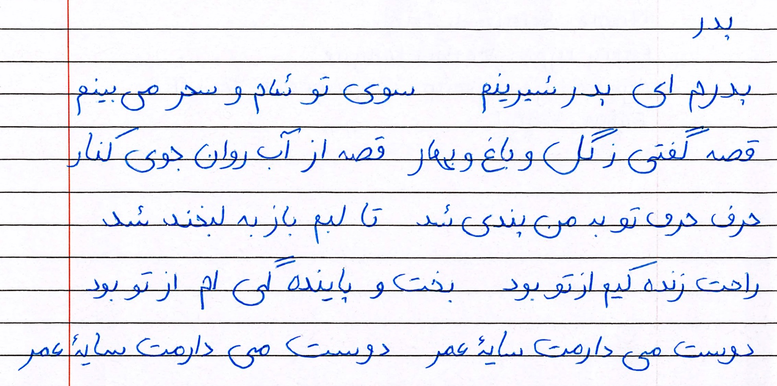
Setayesh Azizi (Year 9)
Whalley Range High School for Girls
Fathers
This is a Persian poem about how much our fathers mean to us and how much we love them.
The poem talks about a young child listening to their father telling them stories, which brings them much happiness. This poem is taught to children around Year 3 to 5 in Afghanistan.
The poem is important to me because it ends with the young child expressing the love they have for their father, which is written beautifully and is very heart-touching, using many techniques, such as repetition.
I recently learned this poem, just as the children in Afghanistan have.
By Setayesh Azizi (in Persian)

Slide 47
Congratulations to all our Mother Tongue 2024 winners…
Angelin John | Kitty Yan | Aadya Arya | Tolin Khalil | Menna Almusawi | Sama Sahhab
Inrah Seedat | Eliyana Tesfalem | Victoriay Ivanova | Calista Certan | Laaibah Arshad | Polina Boichuk
Iris Leung |  | Sahana Jayachandran | Nastaran Sharifi | Qaali Daahir | Rea Sejdiu
Zainab Hamid | Saqib Abid | Aleena Afrin | Toshiba Rennymon | Huma Hussain | Marina Tonu
Saimah Patel | Hannah Mintoff | Tynka Zemanová | Arwen Amin | Elif Zehra Iris | Luca Mullaney
Suriya Bagri | Sibbir Salehin | Zuzanna Dawidziuk | Al Ayman Sarker | Ireoluwa Adeyeye | Emaan Baloch
Johan Abreu | Isabelle Manoj | Pola Ludant | Freya Candeland | Charvy Gali | Setayesh Azizi

Slide 48

Thanks to our wonderful judges…
Ching Yan Chan (Erika)
BA Social Work
Rebecca May Magalhaes (Becky May)
MA Creative Writing
Connie Rigby
MFA Creative Writing
Anita Ngai
MFA Creative Writing
Laura Martin-Cisneros
Spanish Tutor
Lebonetse Khubamang
BA Linguistics
Humayra Rahman Begum
Business Management with Spanish
Nazia Dina
Library Assistant
Sumithreyi Sivapalan (Sumi)
PhD
Abhijeet Singh
MFA Creative Writing

Slide 49
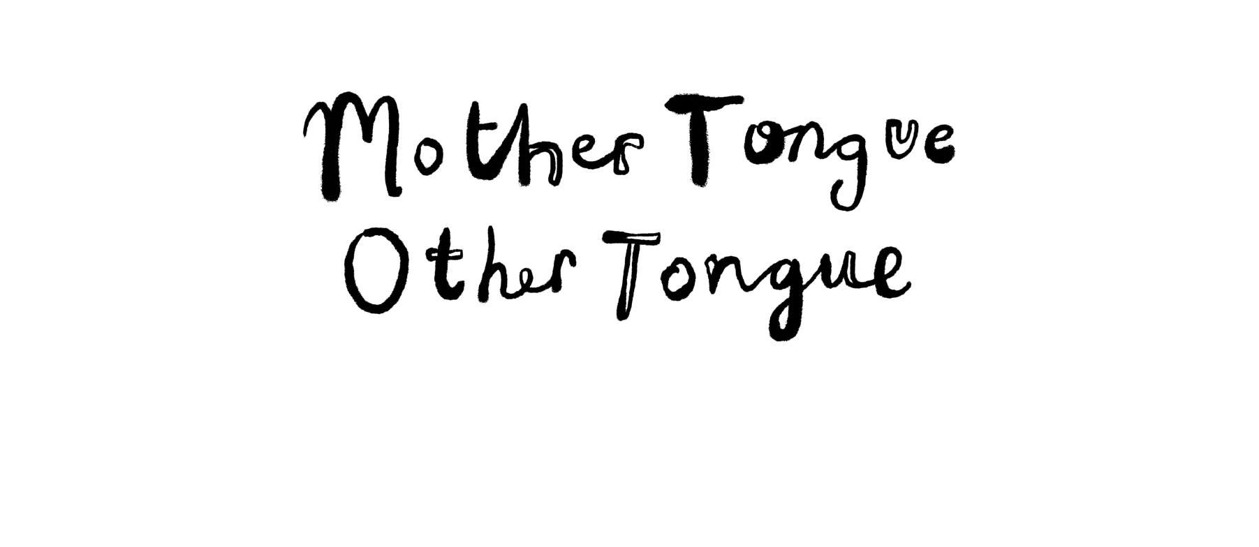
Edited and created by the Manchester Poetry Library at Manchester Metropolitan University, Mother Tongue Other Tongue was created by Professor Carol Ann Duffy DBE, Creative Director of the Manchester Writing School at Manchester Metropolitan University.
“Through the many languages of poetry, in multiple tongues, we can hear the truths of this world we must learn to share.”

Slide 50
2024

Slide 51
This year 2700 young people between the ages of 8-18 took part in Mother Tongue Other Tongue.
Our judges read 250 entries from 38 schools, in 50 languages.
Other Tongue invites young people to be creative in a language they are learning by creating an original poem or a song.
These poems were read by native speakers of the language, who have shared their comments about the poems and what they liked about them.

Slide 52
Congratulations to all our Other Tongue 2024 winners!

Slide 53
Other Tongue winners this year came from:
All Hallows Catholic College | Archbishop Blanch C of E High School | Bolton School Girls Division | Bridgewater Primary School
Bury Grammar School | Cheadle Hulme High School | Co-op Academy Priesthorpe | Dean Trust Ardwick
Didsbury High School | Fairfield High School for Girls | Falinge Park High School | Fallibroome Academy
Lancaster Girls Grammar School | Laurus Cheadle Hulme | London Academy of Excellence | Manor Park School and Nursery
North Halifax Grammar School | Oldham Sixth Form College | Sale Grammar School | St Bernard's Catholic High School
St John Fisher Catholic High | St Monica's RC High School | Weatherhead High School | Whalley Range High School

Slide 54
Winning Other tongue pieces were written in…
French
Spanish
BSL
Swedish
German
Our winners were aged 8-18 – we hope you enjoy reading their work as much as we did…

Slide 55
Die erste Seite
Die erste Seite
ein neues Kapitel
im Schnelldurchlauf durch Geschichten.
Endlose Freude, Liebe und Leid
Glück zwischen den Zeilen
Ich weiß, dass ich hierher gehöre
Spät nachts
schläft nur ungarn
Ich würde lieber weitermachen
What the judges said…
The judges really identified with this sweet poem ‘the first page’ and appreciated the poet’s love of reading.
By Phoebe Robinson (Year 8)
All Hallows Catholic College
German

Slide 56
El tren del tiempo
El tiempo como un tren corriendo en su camino,
con cada momento del día.
No te sientes y te quejes cuando se haya ido, pero siéntate y mira cómo se ha ido
El tiempo como un tren corriendo,
por la vía llevando todos los recuerdos,
pero nunca regresando.
Sube a bordo hacia lo desconocido,
o párate solo en la parada.
What the judges said…
Although this piece is short, it offers a powerful reflection on life. We really liked the metaphor of time being like a train, and how although we can never return to where we´ve been, we can choose to travel towards the unknown, or stop where we want. The rhythmical sounds of the poem reminded us of the rhythm of a train.
By Hannah Gingles (Year 8)
All Hallows Catholic College
Spanish

Slide 57
El Sol Brilla de la Lluvia
El sol brillará después de la lluvia,
Sin embargo, bajo la lluvia, caían
Como Lágrimas incluso como bailarinas caen suavemente desde el oscuro cielo nublado,
Mientras el cielo llora,
Mientras los cristales caen del cielo.
Despacio, despacio
El sol muestra su rayo
Hay algo especial en cómo se ve cuando acaba de llover.
Brillante
Los rayos del sol sobre los charcos los hacen brillar
El cielo azul como el más puro de los zafiros.
Así como se sentía la vida cuando parecía que la lluvia nunca terminaba
Cuando la vida es cruel,
Cuando la vida es dolor,
Encontrarás la belleza otra vez
La vida será paz,
Encontrarás paz,
Serás libre.
El sol brillará después de la lluvia.
By Niamh McMonagie (Year 8)
All Hallows Catholic College
Spanish
What the judges said…
This is a beautiful poem full of hope with an impressive use of images that made us see the world differently – the way the rain falls like dancers, how the blue sky is like sapphires. We also really liked the use of repetition in this piece, especially how the end of the poem returns to the beginning and we realise that, as a reader, we have been changed.

Slide 58
Aprender
By Caitlin Rogers (Year 9)
Dicen que la insti es para aprender
Pero, ¿qué significa esto realmente?
¿Quieren aprender solo sumas y restas,
O cómo analizar un poema?
En realidad, aprender es mucho más que esto.
Aprender significa dolor,
Aprender significa pruebas.
Significa perder amigos,
Significa manterse fuerte.
Hay desafíos que luchar
Y luchas que superar.
Pero luego hay otranto cara del aprendizaje una vez más.
La parte donde aprendes a perdonar,
Olvidar y seguir adelante.
La parte donde dos extrañeros se hacen amigos
Y aprendes a apoyarlos y escucharlos.
Y así, al final, aprender significa mucho más
Que escuchar hablar a los profesores.
Significa amor, respecto y confianza para
Hacer lo que mejor sabes hacer.
Archbishop Blanch C of E High School
Spanish
What the judges said…
There was nice cadence to this poem and it made great use of repetition. We liked the insights into learning.

Slide 59
Pasada y Presente
Mientras doy los pasos por el camino de los recuerdos,
El camino es recto, fácil y claro.
Siento el calor de la infancia filtrarse profundamente en mi cerebro,
No tengo nada que perder ni nada que temer.
Mientras el sol brilla,
Iluminando las imágenes que me rodean.
Todas mis preocupaciones se sienten ligeras,
Sé que aquí es donde quiero estar.
La brisa fresca envuelve
Como una manta cálida y reconfortante.
Pero ese sentimiento ya no se puede encontrar,
Mientras me empujan a un planeta completamente nuevo.
El futuro está nublado,
Todo empañado por la preocupación.
Intenté superarlo,
Desesperado y con prisa.
Mi visión está borrosa,
No puedo entender.
No puedo sacar mis palabras,
Nunca puedo cumplir con las demandas
Mientras recorro el camino que tomará el futuro,
Poco a poco me doy cuenta de que el camino no será recto.
Mi mente se siente pesada por el peso de mis errores,
Pero sé que las cosas mejorarán, sólo tengo que esperar.
What the judges said…
By Fiyinfoluwa Okupe (Year 9)
We liked the way the poem dealt with such a relatable topic – about exams and an uncertain future. This showed a nice personal touch and explored good progression of feelings.
Archbishop Blanch C of E High School
Spanish

Slide 60
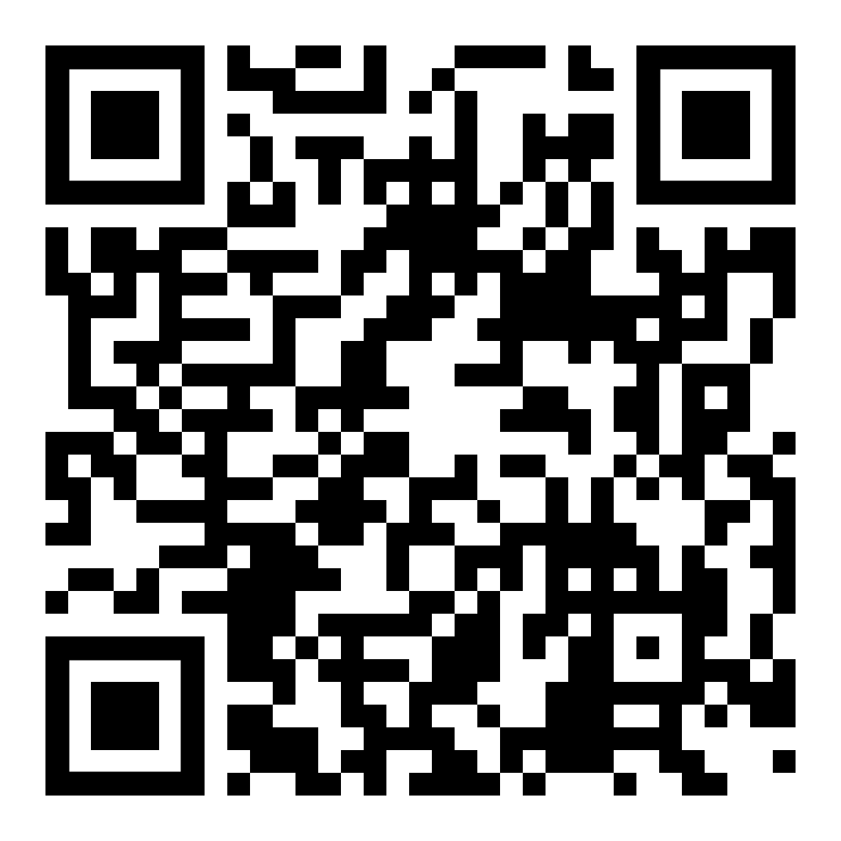
Hands Build Image
This poem intends to use the beauty of the language to represent any poetic forms, such as stanzas. This is because sign language is not a written language.
As I am not fluent myself, I have attempted to use correct grammar, as BSL uses a different form of grammar to standard English.
I structured the poem in this way as I wanted the silence of the video to show how the Deaf community has been silenced, and also to help replicate how Deaf people see the world differently. This also helps to focus the watcher on the signs, and the true beauty of BSL.
The translation provided shows exactly the signs I have used and what this would say in standard English. I wanted this separate piece also to be symbolic, as it shows how society have ignored the differences in the two languages, in terms of grammar, and how the Deaf community are being corrected, despite using their own grammar.
The poem itself questions why we haven’t made use of this beautiful language and ignored it until recent times, when the UK officially recognized it as a language.
By Ella Moss
Arts Emergency Manchester
BSL

Slide 61
Une Ville Qui ne Dort Jamais
Le soleil se rend
Pour que l'étoile brille
Et illumine le ciel sombre.
La lueur des étoiles
tout Paris
La foule s'élargit
Autour de la Tour Eiffel
En attendant qu'il vole la vedette
A chaque minute qui passe, l'horloge glisse
Chaque instant glisse, disparaît
comme la fleur au printemps
Tombe dans un froid glacial,
Mais Paris change…
Au lieu de cela, la foule devient plus bruyante
Et plus fort, plus gros, plus gros
Parce que cette ville
Cette ville
Qui scintille dans l'obscurité
Cette ville
Où les souvenirs s'effacent en douceur
C'est la ville qui ne dort jamais
Même dans les moments terribles
Un morceau de Pâté en croûte
Me ramène
Vers la ville qui ne dort jamais
PragnYa Nath (Year 8)
British School Muscat
French
What the judges said…
We enjoyed the playful use of language and metaphors and liked the mention of “pâté” at the end (like Proust’s madeleine).

Slide 62
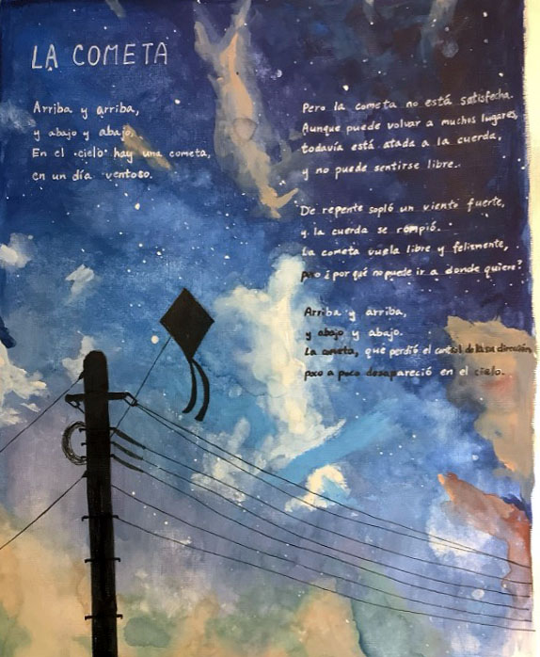
La Cometa
Arriba y arriba,
y abajo y abajo.
En el Cielo hay una cometa
en un día ventoso.
Pero la cometa no está satisfecha.
Aunque puede volar a muchos lugares,
todavía está atada a la cuerda
y no puede sentirse libre.
De repente sopla un viento fuerte
y la cuerda se rompe.
La cometa vuela libre y feliz
pero ¿Por qué no puede ir a donde quiere?
Arriba y arriba
y abajo y abajo.
La cometa, que pierde la control de su dirección,
poco a poco desaparece en el cielo.
What the judges said...
Some lovely repetition and for me, the image of a kite being tied down and not being able to go where it wanted was a metaphor for how life feels sometimes.
By Kylie Cheung (Year 10)
Cheadle Hulme High School
Spanish

Slide 63
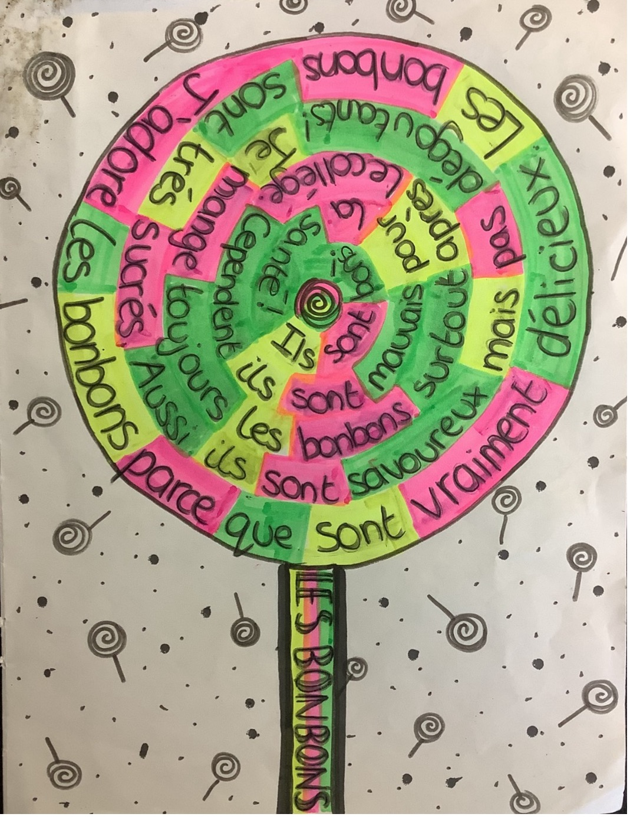
Les Bonbons
J’adore les bonbons parce qu’ils sont vraiment délicieux.
Les bonbons sont très sucrés.
Aussi ils sont savoureux mais pas dégoutants!
Je mange toujours les bonbons surtout après le collège.
Cependant ils sont mauvais pour la santé!
Ils sont bons!
By Charlotte Bradley (Year 8)
Cheadle Hulme High School
French
What the judges said…
A sweet little poem, made our mouths water. We loved the illustration, too. We assume the student’s classmates would relate to this poem well. The creative use of form shows the student’s appreciation of poetry’s flexibility.

Slide 64
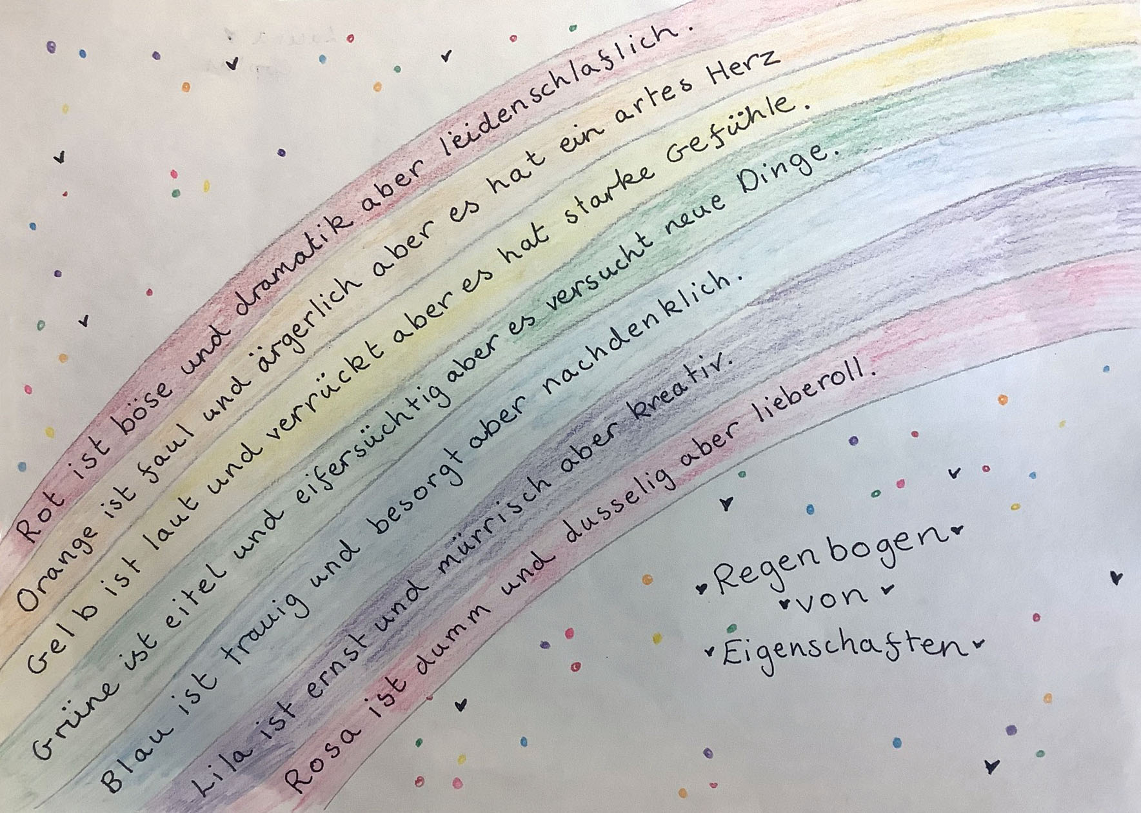
Regenbogen von Eigenschaften
By Laura Copley (Year 8)
Cheadle Hulme High School
German
What the judges said…
This poem was written with lots of care and detail and uses a lot of challenging German vocabulary. It reminded us of the great German poet Johann Wolfgang von Goethe, who wrote his own Theory of Colour around 200 years ago. He also attributed each colour certain characteristics and, as in this poem, these character traits are a mix of negative and positive.

Slide 65
C'est Moi
Je m’appelle Zach.
J’ai deux ans.
J’ai les cheveux très blonds.
J’aime beaucoup le pain grillé mais je déteste les légumes.
J’adore jouer avec des voitures et des jouets.
C’est moi!
Je m’appelle Zach.
J’ai cinq ans.
J’aime l'école et j’adore mon chien parce qu'il est très amusant.
J’adore Lightning Mcqueen!
Je m’entends bien avec mon frère car il est sympa.
C’est moi!
Je m’appelle Zach.
J’ai huit ans.
J’aime jouer avec mes amis à Roblox.
Je voudrais un chat mais mon chien les déteste!
Je m’entends mal avec mon frère car il est agaçant.
C’est moi!
Je m’appelle Zach.
J’ai onze ans.
J'adore le foot car je passe du temps avec mes amis.
Je déteste les hamburgers parce que le boeuf est dégoûtant.
Je m'entends parfois bien avec mon frère.
C’est moi!
Je m’appelle Zach
À ľavenir, j’ai quarante ans. J’ai les cheveux gris!
Je m’entends très bien avec ma famille, même mon frère.
J’ai un chat qui s’appelle Billy.
J’adore être détective car c’est amusant et très intéressant.
C’est moi!
By Zach Farnell (Year 7)
Cheadle Hulme School
French
What the judges said…
We liked the structure of this, exploring life’s themes through repetition. It made us smile at the end (and feel old!)

Slide 66
Las arenas movedizas del tiempo
Una vez no fui nada -
Ni un granito de arena.
Entonces nací.
Yo era un niño pequeño
A punto de empezar la escuela.
Estaba disfrutando de mi tiempo en la escuela primaria
Pero terminó 10 minutos después de empezar.
Ahora me enfrento a los retos de secundaria -
El tiempo es milagroso pero extraño.
El tiempo pasa tan despacio cuando estás en el presente
Pero cuando miras atrás,
Ha pasado en un segundo.
Las arenas movedizas del tiempo.
What the judges said…
We loved the framing device of the grains of sand and the thoughtful reflections on the passing of time.
By Alistair Burgess (Year 7)
Cheadle Hulme School
Spanish

Slide 67
Vacaciones
¡Sueño con mis vacaciones en España!
Sueño con mis vacaciones en España -
Cuando vi un caballo fantástico,
Cuando jugamos en la playa,
Cuando hicimos turismo.
Sueño con cuando me bañé en el mar,
Cuando asistí a un partido de fútbol,
Cuando vi un camaleón -
Que se llamaba Pascal.
Sueño con cuando comí la comida típica,
Cuando vi un flamenco pequeño,
Cuando vi una puesta de sol hermosa,
Cuando salí con mi hermano.
Sueño con cuando fuimos a un restaurante italiano,
Cuando vi un delfín con mi abuela,
Cuando visité una tienda nueva,
Sueño con mis vacaciones en España.
By Georgina Herrington (Year 8)
Cheadle Hulme School
Spanish
What the judges said…
A very personal account of holidays enjoyed, using repetition and containing lovely images of a holiday in Spain. Like a series of holiday snapshots that make you want to go back and do it all again.

Slide 68
Die Welt ist wunderbar
Bella Italia, kochen kann man lernen,
Pizza und Pasta - sind zum Schwärmen.
In Spanien tanzt man Flamenco mit Anmut,
Die Bewegung und die Musik sind nur zu gut.
In Frankreich genießt man Croissant und Skifahren!
In Griechenland gibt es Oliven und antike Ruinen.
In Norwegen, wo die Hügel so klar erscheinen,
Lernt man die Natur zu lieben und bringt einen fast zum Weinen.
Und zurück in England nach all der Reise,
Tee und Kuchen auf britische Art und Weise.
Einfach und schön, die Welt entdecken,
Mit jedem Land die Neugier erwecken.
By Idris Latif (year 8)
Cheadle Hulme School
German
What the judges said…
This poem had really good engagement with form. It rhymes and is very well composed.

Slide 69
La guerre c'est l'enfer
La tragédie partout
Effusion de sang, bataille et guerre
J'espère que tu es heureux là-bas
Tragédie, je me dirige vers le no man’s land
Demain à l'aube
Il est peu probable qu'il revienne
Mais s'il te plaît, ne pleure pas
Je mourrai au service du roi et du pays
Écoutez le bruit des mitrailleuses
Entendez l'hélice tourner
Alors que les zeppelins glissent sous le soleil
Alors que le monde continue son péché régnant
Les lumières sont éteintes
Le monde est plongé dans l’obscurité alors que les bombes crachent leur éclat explosif.
Tout s'est passé ; tous aveugles;
Se battre encore et encore
Je ne sais pas quoi trouver
Les sacs à dos sont une tonne
Au fond se trouvaient des poumons corrompus par la mousse
Comme nous avons accueilli le gaz
nous avons chanté nos chansons
Et mets notre masque
Pourtant, les hommes marchaient péniblement et péniblement
La plupart sans bottes
Mais boitait à cause du sang versé, épuisé
Personne n'a entendu les tirs lointains
Ou la pluie d'obus à gaz tombant doucement autour
Un soldat tire la sonnette d'alarme
Mais les obus avaient déjà atteint le sol
By Madeline Roberts (Year 8)
What the judges said…
Co-op Academy Priesthorpe
French
A heartfelt poem about war, using good variation of language and images and capturing the suffering and confusion of soldiers in the battlefield very well. The lack of punctuation in this poem throws the reader into a world where the rules are not followed and they have to figure things out for themselves.

Slide 70

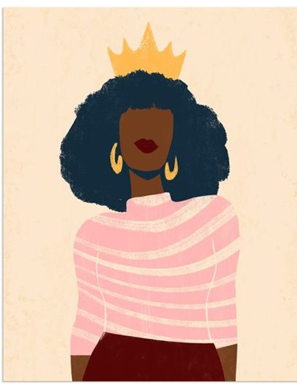
I am a woman from Guinea
What the judges said…
Je suis une femme
Oui je suis une femme
Oui je suis une madame
Je dois accepter un polygame et je dois pas faire d’amalgame
Ma maison se trouve dans la cuisine
J'accepte la douleur comme après une injection de lidocaïne
Je fabrique des bébés comme une usine
J'ai ete exciser
Pour ne pas être exciter
Je dois toujours être parfaite même épuisé
Je dois être parfaite
Même sans être contrefaite
Je dois faire de longues études
Pour ne pas finir par être sa maigritude ordure
Sans jamais recevoir sa reconnaissance
Je dois me taire et accepter son adolescence
This is a wonderful poem that does not mince words or try to sugarcoat female oppression. It conveys the blunt, brutal truth.
By Fatoumata Camara (Year 11)
Dean Trust Ardwick
French

Slide 71
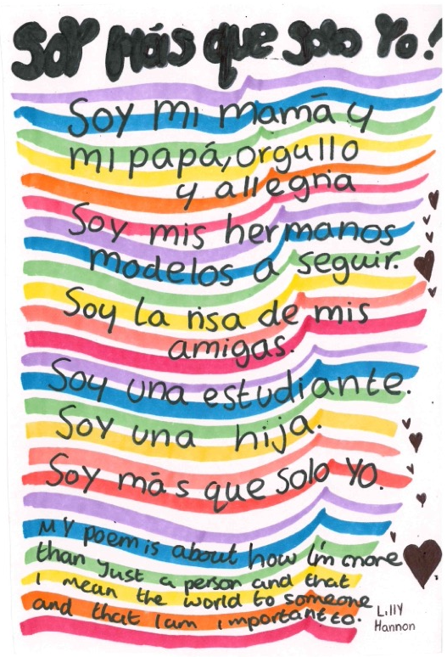
Soy mas que sola yo
By Lilly Hannon (Year 7)
Didsbury High School
Spanish
What the judges said…
A short and deceptively simple poem about all the people we are to the people in our lives.

Slide 72
En sombras profundas
En sombras profundas,
pesado y frío,
En silencio lleva carga
sin brío,
Un corazón frágil
es lo que queda,
No puede liberarse
de las cadenas,
Un espíritu roto,
al límite llegando
El luche silencioso,
De un alma quebrada.
By Raiyaan Mawlood (Year 8)
Didsbury High School
Spanish
What the judges said…
This sophisticated poem had a nice cadence and rhythm to it and was memorable.

Slide 73
Mon Avenir
Je veux vivre en France,
Je veux visiter les monuments et explorer la campagne,
Je veux danser au ballet de l’opéra de Paris,
Je veux faire des pirouettes sous les étoiles,
Je veux faires des pas du chat et fouettés dans toute la ville,
Je veux posséderai un grand manoir,
J’aurai une piscine dans mon jardin,
Je serai le meilleur que je peux être,
Je vais aller loin,
Je vais être fier de moi,
Je vais faire plaisir à ma grand-mère.
By Alexa Garrett (Year 8)
What the judges said…
Fallibroome Academy
French
Passionate poem, with good images. We liked the mention of Grandmother at the end and the hints at family history and heritage.

Slide 74
Mi dia
Verse
Me despierto por la mañana, el sol brilla con fuerza,
Salgo de la cama, es hora de empezar bien el día
Me lavo la cara, me cepillo los dientes, me siento fresca y limpia
Preparo el café ¡la rutina perfecta!
Chorus
Es mi rutina matutina, ¡ah sí!
Moverme, sin tiempo que perder
Es mi rutina matutina, ¡vamos por allí!
Sin pensar en el mañana y el ayer
Verse
Me visto con estilo – sí, estoy de moda
Me miro al espejo, sintiendo como una estrella
Entonces desayuno - frutas y cereales
La comida más importante, sin mencionar mi favorita
Chorus
Es mi rutina matutina, ¡ah sí!
Moverme, sin tiempo que perder
Es mi rutina matutina, ¡vamos por allí!
Sin pensar en el mañana y el ayer
Bridge
Luego hago ejercicio, pongo mi cuerpo en movimiento
Saltando y moviéndome, lista para todo
Escuchar música me llena de alegría
¡La aprovecho al máximo - la mañana es mía!
Chorus
Es mi rutina matutina, ¡ah sí!
Moverme, sin tiempo que perder
Es mi rutina matutina, ¡vamos por allí!
Sin pensar en el mañana y el ayer
By Tess Naughton (Year 9)
Fallibroome Academy
Spanish
What the judges said…
This song put a smile on our faces. It’s not easy to write a rap in another language and we loved the way the piece was structured as a song.

Slide 75
Mi Familia y Mis Mascotas
En mi casa hay alegría,mi familia es compañía.
Papá, mamá, y mi hermana, todos juntos en la mañana.
Tenemos un perro travieso, y un gato que es muy tieso.
Con ellos juego sin parar, y nunca dejo de soñar.
Mi abuela cuenta historias, de viejas y grandes glorias.
Y mi abuelo con su risa, siempre trae mucha prisa.
Mis mascotas y mi gente, me hacen sentir tan valiente.
Con amor y con cariño, soy feliz desde niño.
By Harrison Eyre (Year 8)
What the judges said…
Fallibroome Academy
Spanish
We really liked the rhythm in this poem. It is funny and makes good use of rhyme.

Slide 76
Die Hibiskusblume
Haben Sie von der Hibiskusblume gehört?
Symbol für Romantik und Zuneigung
Ihr Seelenverwandter traumverloren
Das Geschenk das blüht in einer Beziehung
Allerdings zeigt sie auch die wahre Schönheit
Die eine Ewigkeit andauert
Nach der sich Menschen sehnen
Schönheit und Liebe sind eine Sucht
Rot, gelb, rosa, blau, lila, orange, weiss
Die vielen Farben der Hibiskusblume
Gefunden in Orten wo es tropisch und heiß ist
Mädchen tragen sie in ihren Haaren
In der Hoffnung ihren perfekten Partner zu finden
By Rita Knowles (Year 12)
What the judges said…
Fallibroome Academy
German
A poem that works well in German, with nice themes and ideas.

Slide 77
We Sind Alles le Même
Although you utter words I cannot distinguish,
When things grow dark, cold, bleak, I needn’t have to,
For all hearts beat as one in a rhythm we all understand,
I can see the glimmer of your eyes, iridescent with hope,
I can understand the brightness of your smile, alive with glee,
I can hold your hand and you can hold mine,
We can find our feet together and make our own path toward light,
We don't need shared tongues to embrace every member of our world.
Wenn unsere Welten kollidieren,
sind wir wie Bienen in einem Bienenstock,
die sich aufeinander verlassen, um zu überleben
Du kamst zu meiner Hilfe,
obwohl ich Deutsch sprach,
Wir sind alle nur Menschen.
Tes cheveux roux, les miens bleus,
Ta langue germanique.
La mienne est romantique,
Nous sommes tous pareils,
Tous ensemble,
Sur cette planète, nous vivons chez nous.
No matter what language we speak, we are all the same,
Peu importe la langue que nous parlons, nous sommes tous pareils,
Egal welche Sprache wir sprechen, wir sind alle gleich,
Indiferent de ce limbă vorbim noi toți suntem la fel,
неважливо якою мовою ми розмовляємо, ми всі однакові.
By Chloe Ainscough (Year 10)
What the judges said…
Fallibroome Academy
German, French and English
A wonderfully creative poem. We loved the way the poem used a variety of languages and particularly liked the last stanza, with the same line repeated in different languages ‘We are all the same, no matter what language we speak’. A powerful message.

Slide 78
Le Silence
By Isla Gordon (Year 12)
On croit en langue;
On croit en langue parlée, en gestes à la main, en mouvement.
On croit en pensée;
On croit en pensée inexprimée, en coups d’œil, en souvenirs.
On vit en chuchotements doux, en cris de la douleur,
En sourires et en rires.
On fait confiance au bruit.
Nos pensées, nos mots, nos actions,
Ils viennent tous de la même chose:
Nos esprits.
Penser,
Faire,
Ressentir,
Tout le temps.
Toujours occupé.
Il y a du bruit,
Dans nos esprits.
Il y a du bruit,
Dans tout ce qu’on fait,
Dans la vie quotidienne.
Mais, il y a de la beauté, dans le silence.
Dans le lever et coucher du soleil,
Dans les chuchotements doux, qui effleurent les vagues de l’océan,
Dans le noir perçant de la nuit, qui est brisé par un million de l’étoiles.
C’est la sorte de silence,
Qui est tellement forte,
Tellement vaste,
Qu’on ne peut pas la décrire,
Avec toutes les langues.
Mais, ce n’est pas du bruit.
C’est calme, et c’est tranqille.
C’est de la musqiue.
Et c’est sa propre langue.
Ce transcende le bruit.
On n’entendra jamais ses subtilités.
On ne l’utilisera jamais.
On ne la comprendra, jamais.
Mais de temps en temps,
Quand les vagues calment le sable,
Quand la neige transforme les champs verts en toiles vierges,
Vous la ressentirez.
Lancaster Girls Grammar School
French
What the judges said…
This poem, about beauty in the silence of nature was memorable and well constructed. Isla offered an explanation about her poem, which said that ‘humans are always talking or thinking. We never stop to observe how all the intricate, quiet sounds of nature intertwine. The silence is complex and beautiful, like music, like a symphony; it communicates like a language.’ We thought both the poem and Isla’s own description of it just beautiful.

Slide 79
Le Tournesol
Quelque peu plus élevé que les autres,
il se balance à la brise,
l'incarnation d’élégance.
Il ne se passe jamais une journée
que je n’aperçoive pas son visage.
Ses pétales d’ambre brillent au soleil,
une auréole d’or chiffonné ;
la plus lumineuse de tous.
Chaque jour, je m’attends à son regard habituel-
l’entrelacement quotidien de nôtres âmes.
Mais l’illusion prend fin fugitivement,
car quand je me retourne,
Je vois le véritable possesseur de son attention.
Il brille depuis les cieux, son éclat incandescent
brûle chaque trace d’espoir lorsqu’il observe
sa congrégation fervente.
Alors qu’il jette un coup d’œil
à la prairie entière,
la fleur est le seul point de ma conscience.
Il sera à jamais un tournesol, mais je ne serai jamais le soleil.
By Ellie O’Hare (Year 12)
What the judges said…
Lancaster Girls Grammar School
French
A well-constructed poem with memorable images. We enjoyed the details of the sunflower, it felt very spiritual.

Slide 80
Der Maler
By Daisy Crow (Year 12)
Der Maler sitzt vor dem Fenster;
Seine Wohnung ist hübsch, aber klein.
Er hält Aquarelle in der Hand und sagt sich:
„Was wird mein Gemälde sein?”
Die Farbe sind Lila und Rosa,
Und Gelb, Grün, Orange, Rot und Blau,
Aber der Maler ist ziemlich traurig
Denn die Großstadt draußen ist grau!
Er sieht keine Kinder auf der Straße,
Er sieht keine Tiere im Park,
Er sieht nur Gebäude und Elend
Doch der Maler ist sehr willensstark.
„Meine Blume sind lila und rosa,
Und der Himmel hoch oben ist blau
Zusammen sind sie schön und ich liebe sie alle
Denn sie sind überhaupt nicht grau!”
Lancaster Girls Grammar School
German
What the judges said…
This was a really creative poem and well executed poem that uses poetic techniques, especially rhyme, well.

Slide 81
Finales e inicios
Hay un aroma en el viento
Un aroma de tierra calentita
De flores frescas y hojas verdes
Oigo un canto de avecita.
Pronto, el año terminará,
Mi último año aquí.
No puedo imaginarme sin este lugar,
Ni este lugar sin mí.
Con viejos y nuevos amigos,
He aprendido aquí, he crecido.
Ya no soy un niño,
En un adulto me he convertido.
Una puerta se está cerrando,
Pero ¡no tengas miedo!
Otra se abre, y a través,
Ya puedo ver el cielo.
El cielo es más grande
Que la vida hasta la fecha;
Yo podría ser aún mejor
De lo que el mundo sospecha.
Luego debo volar, pero volveré
Antes de que te des cuenta.
Quizás podrías unirte a mí,
De viajar no estás exenta.
Por el momento, me siento aquí,
Huelo la brisa de primavera.
Disfruto el final de esta época,
No olvidaré cómo era.
By Cate Matthew (Year 12)
Lancaster Girls Grammar School
Spanish
What the judges said…
This poem feels very personal and has the rhythm and themes of much Spanish poetry. We liked how nature was used and the reflection on how one chapter ends as another begins.

Slide 82
A Veces no se Como Explicarlo
A veces no sé cómo explicarlo,
a veces siento como el diablo,
pero, a veces eso no es el caso, a veces pienso que soy un mago,
con mis trucos y tratos,
y cuando pienso eso, estoy feliz,
y me olvido de esas memorias malas,
pero eventualmente me recuerdo,
y las memorias me vienen como cien balas disparando.
By Theo Thompson (Year 6)
What the judges said…
Manor Park School and Nursery
Spanish
Absolutely brilliant poem, written in Spanish, with great use of rhyme and repetition.

Slide 83
¿Quiénes son los niños?
¿Quiénes son los niños?
¡Somos niños!
Niños con voz.
Niños con opción.
Niños que ven cómo cambia nuestro mundo,
Y cambian con ella.
Niños que reflexionan.
Niños que se preguntan.
¿Quiénes son los niños?
¡Somos niños!
Niños que se sienten sin voz.
Niños que se sienten sin opción.
Niños que se preguntan cómo sería ser adulto,
Y como se verán.
Niños que quieren una voz.
Niños que faltan una elección.
Niños que representan el futuro.
¿Quiénes son los niños?
¡Somos niños!
Niños que gritan con una voz.
Niños que hablan con una opción.
Niños que desean un cambio en el mundo,
Que pronto será los suyos
Niños que se preguntan con voz.
Niños que reflexionan con una elección.
Así que escuche a los niños.
Escuche a la próxima generación.
Porque …
¿Quiénes son los niños?
¡Somos niños!
Tenemos voz y opciones.
Nos preguntamos.
Reflexionamos.
¡Somos niños!
By Alex Bates, Florence Hollingsbee, Savannah Rose and Xander Williams (Years 5 & 6)
Manor Park School and Nursery
Spanish
What the judges said…
We enjoyed this lovely collaboration and its strong message about what is needed in the world today.

Slide 84
Undergångsblå
Natten krymper och stjärnorna slutar dansa
Värden slutar vända men himlen förblir
Undergångsblå
Vem mer tittar på månen ensam
Vem mer dansar i regnet ensam
Vem mer ser hur himlen blir
Undergångsblå
Nyx sover när ljuset sköljer över landet utan dig
Men vem mer ser hur himlen blir
Undergångsblå
När solen går upp på den blå himlen
Då blomstrars livet i dess strålar
Men vem mer
Vem mer kommer alt dö för alt skydda vårt hem
Vårt hem skyddat av domedagsblusen
Vem mer ser hur himlen blir
undergångsblå
By Matthew Sykes (Year 8)
North Halifax Grammar School
Swedish
What the judges said…
Undergångsblå (Doomsday Blue) is a powerful poem about the protection of the land we live on and how important it is to love and respect all the earth has to offer. It describes how the earth keeps turning and all the flora and fauna exist in a harmonious balance whether anyone cares or not. We were also particularly impressed to hear how Matthew is learning Swedish in his free time and glad he chose to be creative with his new language in this way.

Slide 85
Un viaje extraordinario
En el vasto universo, un viaje emprenderé,
donde las estrellas y planetas, mi vista cautivarán.
El sol brilla radiante, como un faro celestial,
mientras la luna sonríe, con su luz especial.
En el firmamento, las constelaciones se dibujan,
como un mapa celeste, en la noche se despliegan.
Marte con su rojo fulgor, misterioso y fascinante,
y Venus, la estrella de la tarde, tan brillante.
Saturno con sus anillos, un espectáculo sin igual,
y Júpiter, gigante gaseoso, majestuoso en su lugar.
Las nebulosas danzan, con colores tan vibrantes,
y las galaxias se entrelazan, como hilos brillantes.
El espacio infinito, un universo por descubrir,
donde los sueños se elevan, sin límites a existir.
Astronautas valientes, explorando lo desconocido,
con sus ojos en las estrellas, su espíritu decidido.
En el vasto cosmos, la belleza se despliega,
un recordatorio humilde de nuestra propia entrega.
Así que alza la mirada, y contempla con devoción,
el misterio del espacio, una eterna inspiración.
By Rahima Akhtar (Year 13)
Oldham Sixth Form College
Spanish
What the judges said…
We liked the topic and the ambition of this poem, especially the lines about space and the universe. The use of the planets (as in the old poetic trope of the music of the cosmos, the harmony of the planets, and the general idea of celestial harmony and beauty) gives it a scientific touch, bringing it up to date to the 21st Century with scientific advancements and the fascination with the unknown and the possibilities for knowledge that the universe provokes.

Slide 86
Las Estaciones
En la primavera, las flores empiezan a brotar,
El sol calienta, y el mundo a brillar,
En verano, calor y diversión en el aire,
Jugamos y reímos sin ninguna preocupación,
Llega el otoño, las hojas caen con suavidad,
Los colores cambian, y es casi navidad,
Y en invierno, la nieve en el suelo,
Descansamos y nos abrazamos con gran felicidad.
By Ellis Hague (Year 12)
What the judges said…
Oldham Sixth Form College
Spanish
A lovely rhythm to this poem, following the passing of the year and defining the seasons in few words.

Slide 87
El Abismo Digital
En el brillo de las pantallas, vagamos perdidos, nuestras almas atrapadas por
píxeles, cables cruzados. El mundo exterior se desuanece en el crespúsculo
mientras nos sumergimos de cabeza en la noche digital.
El cellular llama con su canto de sirena, un oráculo de bolsillo, sobre el bien y el
mal. Descubrimos sus secretos con manos temblorosas, cambiando la realidad
por un país de las maravillas virtual.
Estamos atados a nuestras pantallas, como marionetas, los hilos de Wi-Fi nos
atan, no hay escapetoría, no hay arre pentimiento. El mundo sigue girando,
pero estamos atrapados en un bucle, cambiando atardeceres por memes,
connexión por primicia.
Hemos olvidado cómo mirar al cielo, perdidos en el brillo de las pantallas,
apenas lo intentamos y así caemos, silencios e invisibles, en el abismo digital,
donde los píxeles brillan. Nuestras almas píxeladas, corazones fallando,
perdidos en el código, por siempre y un día.
By Rosa Hespe (Year 7)
Poynton High School
Spanish
What the judges said…
An original and ambitious poem on an interesting and pertinent topic; how mobile phones are taking over our lives. Good use of imagery makes this a memorable poem.

Slide 88
Monster in Meinem Kopf
Die Leute sagen, du bist verrückt,
Nur um anders zu sein,
Auch wenn Sie versuchen, sich anzupassen
Manchmal kann man einfach nicht gewinnen.
Es kann dunkel in deinem Kopf sein,
Die Türen sind verschlossen,
Du driftest auseinander,
Die Lichter haben aufgehört.
Du bist nicht allein,
Vertrau mir, ich weiβ
Jeder fühlt sich manchmal so.
Versuche aufzustehen,
Öffne die Türen,
Lass das Licht herein,
Es wird bald besser werden,
Und du wirst dich gut fühlen.
Du musst es einfach versuchen,
Hören Sie nicht auf das, was sie sagen,
Dir zuhören,
Selbst,
Dein Verstand,
Und es wird alles besser werden.
What the judges said…
By Rebecca Hudghton (Year 7)
A powerful poem about emotions and mental health that is calm and reassuring. It conveys a message of hope to anyone who has ever felt alone. Through its recurring imagery of darkness and light, it reminds the reader to take confidence in their own voice. There is a carefully mirroring of the imagery in the structure of the poem, so that it moves gradually from darkness towards light, from being closed off to being open.
Poynton High School
German

Slide 89
¿Quién eres?
Sé que todo el mundo usa una máscara pero eres demasiado falso bajo tu
tierno y bondadoso corazón esconde un alma envidiosa y celosa.
Sé que estás intentado hacer algo eso podría hacerte destacar pero tu
‘buscador de atención’ no vas a lograr.
Sé que estás herido por dentro y sé que no pudiste controlarlo pero solo hay
que superar las cosas por tu cuenta.
By Sachi Ng (Year 8)
Poynton High School
Spanish
What the judges said…
We loved the strong voice in this and the sophisticated understanding of human nature captured throughout.

Slide 90
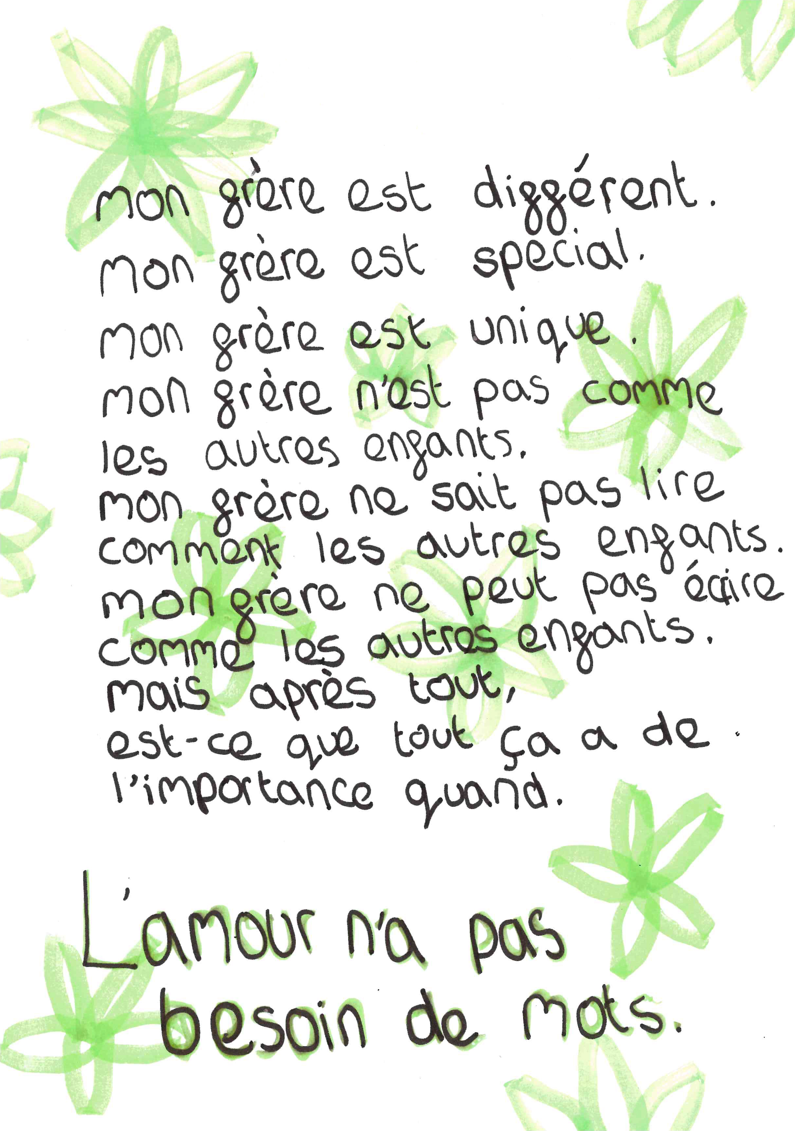
Mon Frere
By Holly Pearson (Year 7)
Priestnall School
French
What the judges said…
A charming and simple poem with a surprising twist. The love for their brother comes through and there is good use of repetition.

Slide 91
Cobayas
Quiero ir a la playa
Quiero ver las cobayas
Que se llaman Maya
Voy a la playa
No veo las cobayas
Que se llaman Maya
¿Dónde está la playa?
¿Dónde están las cobayas?
¿Qué se llaman Maya?
No hay una playa
No existen las cobayas
Que se llaman Maya
Las cobayas se llama…
¡RAYA!
By Lily Marchant (Year 7)
Sale Grammar School
Spanish
What the judges said…
An original poem that was a bit weird and nonsensical but made us smile. Guinea pigs at the beach … who’d have thought?

Slide 92
Le réchauffement de la planète
By Finley Brown (Year 9)
St Bernard’s Catholic High School
French
La vie marine est en train de mourir,
Les océans montent,
Les gens pleurent,
Parce que la température monte.
Nous devons arrêter,
Nous devons aider,
Nous devons faire quelque chose.
Les ours polaires sont coincés sur la glace,
Ils ne peuvent pas chasser le poisson,
Ils sont incapables de survivre,
Parce que la température monte.
Nous devons arrêter,
Nous devons aider,
Nous devons agir maintenant.
What the judges said…
Nice musicality to this poem and a sense of urgency created by the use of verbs in this poem, which was also reflected in the commentary that Finley also submitted. “I have chosen to write this poem as I am passionate about the environment and about conserving the planet. … we must start acting now to save our planet for future generations.”

Slide 93
Le monde change
Le monde est en évolution constante,
Comme le débit d’une rivière.
Des terres anciennes aux cieux modernes,
Il continue à croître.
Avec les progrès technologiques
les sociétés se transforment,
Pendant que nous naviguons
Dans ce monde en évolution.
L’innovation nous entoure,
À chaque coin de chaque rue,
Des gratte-ciels imposants aux gadgets élégants.
Mais, au milieu des progrès, n’oublions pas le passé
Vu que les leçons de l’histoire
Révèlent une sagesse qui durera toujours.
La beauté de la nature demeure
Dans les montagnes hautes et larges,
Dans les océans profonds et les forts vertes.
C’est là où réside la vie.
Chérissons la Terre, notre grande maison
Et protégeons-la des merveilles d’une main aimante.
By George Butler (Year 9)
St Bernard’s Catholic High School
French
What the judges said…
A passionate and descriptive poem, which pairs ideas and images to get across a powerful message about the importance of protecting the environment for generations to come. George says “I am extremely lucky to live in the beauty of the Lake District … it is humbling to look at the majesty of nature, in the knowledge that nature lets us live here for only a short period of time …”

Slide 94
Vom Leuchtturm
Die Wellen brechen sich an Felsen
Und werfen das kalte Wasser hoch.
Das Licht lenkt die Schiffe näher –
Es ist erfolgreich, immer noch.
Die einsam‘ Nacht wird immer dunkler,
Leuchtende Sterne verdunkeln sich,
Schatten fallen auf alte Pfade,
Wellen kämpf‘ am Strand unendlich.
Gegen den Leuchtturm die Wässer tanz‘
La Corbière erstrahlt im Glanz.
By Georgia Haslam (Year 12)
St Mary’s Catholic High School
German
What the judges said…
This is a very well thought out poem, personal and operating at a high level of language and use of poetic techniques.

Slide 95
Sentimiento de hogar
Aquí ne siento libre de hablar
No hay nudos que me hagan sentir incompleto
Siento sentimientos hogareños
Y esta puerta es perfecta.
Mi lengua se mueve con vida
Con mucha alegría
Puedo comunicarme sin guía
Haciendo que mis ojos finalmente se sequen.
Ojalá pudiera quedarme
Pero ese deseo es un desperdicio
Así que estoy guardando eso
Para otro día.
What the judges said…
We liked the idea of the home providing freedom and comfort and the contrast in feelings expressed of the idea of home and the reality of not always being able to find that comfort. The last two verses are particularly impactful, with a message that embeds stoicism about the current situation and optimism that the wish may be fulfilled some day.
By Sophie Watson (Year 8)
St Monica’s RC High School
Spanish

Slide 96
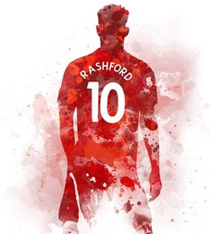
Mi poema español
Rory Cannon es mi nombre
Y creo que Marcus Rashford es EL hombre,
El patea el futbol,
El marca gol tras gol,
Y salvó a los ninos del hambre
What the judges said…
By Rory Cannon (Year 7)
A lovely tribute to Marcus Rashford, written as a Spanish limerick. The judges enjoyed the rhyme scheme and agree that he is a worthy hero.
St Monica’s RC High School
Spanish

Slide 97
Une Poule Domestique
Je voudrais une poule domestique
Avec les plumes jaunes
Avec un petit nœud rose
Une poule qui saute à cloche-pied
Qui danse
Comme un Monsieur Loyal
Je voudrais une poule
Pour saisonner et cuisiner !
What the judges said…
Run chicken, run! This funny poem just made us smile.
By Anu Olugbade (Year 5)
St Richard’s Roman Catholic Primary
French

Slide 98
La Poule
La poule,
Timide, stupide
Qui court, qui danse, qui se bat
La poule est bon pour manger, je préfère,
Qui court, qui chasse, qui accélère
Courageux, intelligent
Le guépard !
What the judges said…
We’ve never heard of a chicken being compared to a cheetah before! Nice rhythm and symmetry in this poem. We felt sorry for the chicken, though.
By William Chibiko-Mbanu (Year 5)
St Richards Roman Catholic Primary
French

Slide 99
La noche
La noche es pacífica
la noche es tranquila
La noche no da alarma
ella te trae
A su abrazo frío
Aunque ella no dará la cara.
Porque la noche tiene miedo
que tendrás miedo
Huye de su oscuridad
Y dejarla llorando
Porque ella no es como su hermana
El día valiente.
El que no se aleja
De la luz, como brilla
Su cálida mirada llenando todo de luz.
La noche tiene envidia
La noche es confusa
¿Por qué la noche no es la musa de todos?
¿Por qué su cara está envuelta en oscuridad?
Mientras su hermana brilla como Arcos Dorados.
Toma la mano de la noche
Y susurrarle al oído
“Sin la noche, el día sería libre.
¿Entiendes lo horrible que sería eso?
Sin dormir.
Sin calma.
Sin tiempo para recargar.
Y una pequeña luz se enciende en el corazón de la noche.
By Paige Williams (Year 8)
Weatherhead High School
Spanish
What the judges said…
An interesting and memorable poem, with a good ending. Full of originality and creativity, we really enjoyed this meditation on the difference between day and night and how we need both.

Slide 100
Espacio
La serenidad silencia mi mente
La quietad me envuelve creando armonía
Mi espacio personal es mi santuario
Conversaciones discordantes y quejas en el air
El frenesí a mi alrededor perturba mi interior
Pero honestamente,
¿cómo puedo empezar a preocuparme?
La necesidad de validación constante consume a las personas a mi alrededor
El clamor por reconocimiento eclipsa la empatía
Pero al final del día , encuentro calma en mi hogar
Solo yo … y la paz
By Freya Candeland (Year 8)
What the judges said…
Weatherhead High School
Spanish
Reflective and life-affirming, an interesting and memorable poem with a message we can all learn from.

Slide 101
Congratulations to all our Other Tongue 2024 winners…
Phoebe Robinson | Hannah Gingles | Niamh McMonagie | Caitlin Rogers | Fiyinfoluwa Okupe | Ella Moss
PragnYa Nath | Kylie Cheung | Charlotte Bradley | Laura Copley | Zach Farnell | Alistair Burgess
Georgina Herrington | Idris Latif | Madeline Roberts | Fatoumata Camara | Lilly Hannon | Raiyaan Mawlood
Alexa Garrett | Tess Naughton | Harrison Eyre | Rita Knowles | Chloe Ainscough | Isla Gordon
Ellie O'Hare | Daisy Crow | Cate Matthew | Theo Thompson | Alex Bates | Florence Hollingsbee
Savannah Rose | Xander Williams | Matthew Sykes | Rahima Akhtar | Ellis Hague | Rosa Hespe
Rebecca Hudghton | Sachi Ng | Holly Pearson | Lily Marchant | Finley Brown | George Butler
Georgia Haslam | Sophie Watson | Rory Cannon | Anu Olugbade | William Chibiko-Mbanu | Paige Williams
 | Freya Candeland

Slide 102

Thanks to our wonderful judges…
Ching Yan Chan (Erika)
BA Social Work
Sumithreyi Sivapalan (Sumi)
PhD
Anita Ngai
MFA Creative Writing
Humayra Rahman Begum
Business Management with Spanish
Nazia Dina
Library Assistant
Abhijeet Singh
MFA Creative Writing
Laura Martin-Cisneros
Spanish Tutor
Lebonetse Khubamang
BA Linguistics
Rebecca May Magalhaes (Becky May)
MA Creative Writing
Connie Rigby
MFA Creative Writing

Slide 103

Edited and created by Manchester Poetry Library at Manchester Metropolitan University, Mother Tongue Other Tongue was created by Professor Carol Ann Duffy DBE, Creative Director of the Manchester Writing School at Manchester Metropolitan University.
“Through the many languages of poetry, in multiple tongues, we can hear the truths of this world we must learn to share.”

