Slide 1
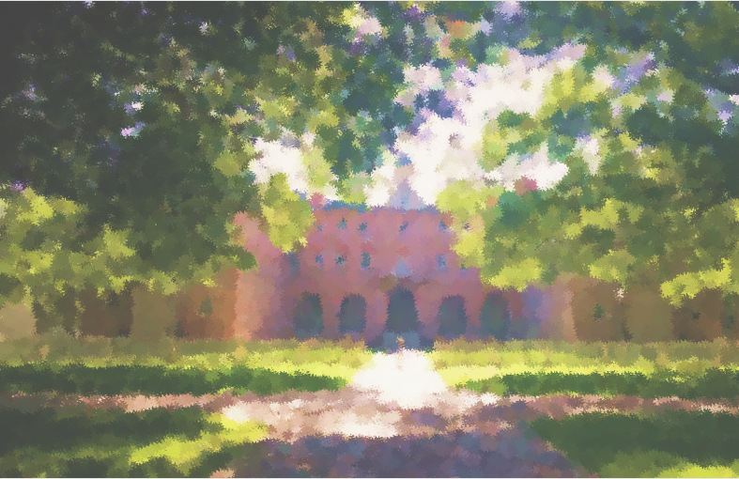
Start
Copyright Heights
Instructions
This game runs as a PowerPoint slide show.
To start the game, press the Shift + F5 keys
Or go to Slide Show > From Beginning.

Slide 2
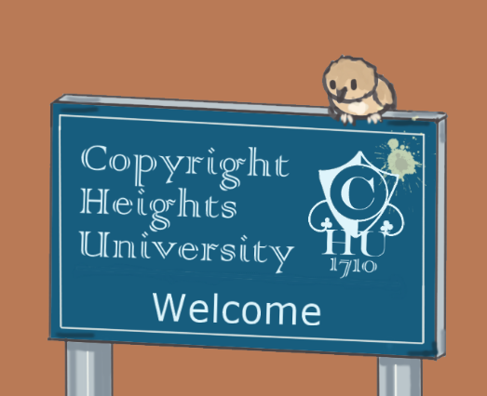
Copyright Heights title screen
Copyright Heights
Play
Help
About

Slide 3
Help
Copyright Heights is a ‘point and click’ visual novel game where you choose different options to explore locations and meet characters.
To navigate through the game, simply click the on-screen options which appear. You can do this using your mouse, touchscreen, or the tab and return keys on your keyboard.
Press the ESC key at any point to exit the game.
Copyright Heights runs in MS PowerPoint.
< back

Slide 4
About
Copyright Heights is a short visual novel game introducing players to basic concepts in UK copyright, including fair dealing, open licences, and the public domain.
In the game you must work out which of your university housemates has infringed copyright, learning how you can legally reuse other people’s work along the way.
Copyright Heights has been developed by the Digital Skills Team at the University of Aberdeen. It is licensed under a CC BY-NC-SA 4.0 licence.
Character art created by Tim Riley. Background art adapted from openly licensed images on Pixabay. Music created by www_lokhmatovmusic_com on Pixabay.
This version of the game has been amended by Kate Woods for use at Manchester Metropolitan University.
< back

Slide 5
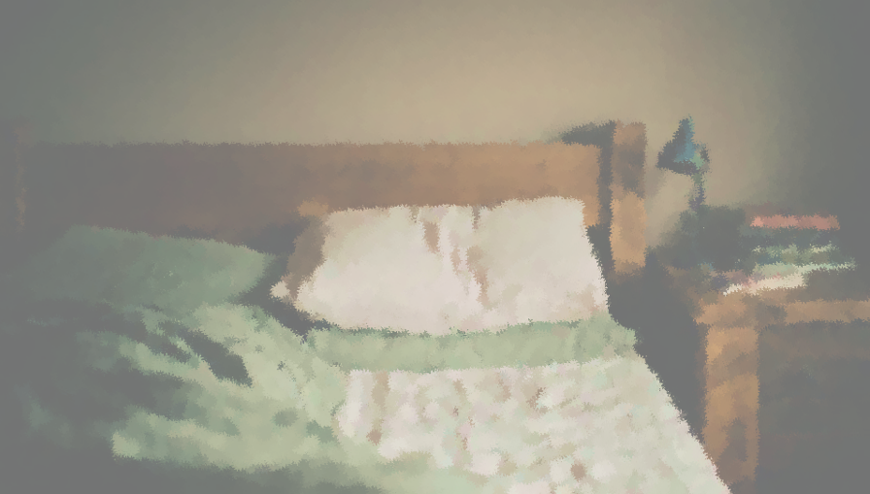
Your student flat 1
Your student flat
You wake up suddenly. A sense of dread grips you, but then you remember: all your exams are over!
You relax back into the sheets. Time for a well-deserved lie-in…
next >

Slide 6
Your student flat 2
Your student flat
BRRRR!!
BRRRR!!
Argh! The doorbell!
Can’t you get a moment’s peace?
Answer the door

Slide 7
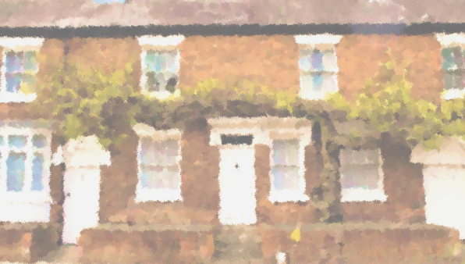
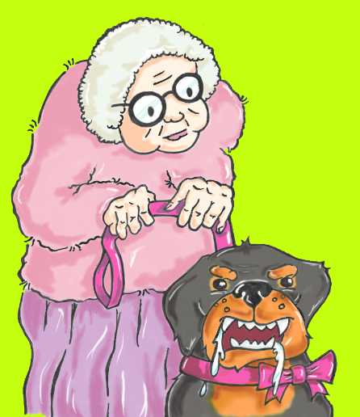
Talk with your neighbour 1
Good morning, neighbour!
The postie put some post for you through my letterbox by mistake.
next >

Slide 8
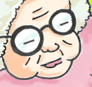
Talk with your neighbour 2
Sorry, but my little Fluffy got hold of it. Hope he’s not eaten any important bits!
The cheeky scamp just can’t resist good 80gsm bond paper!
Look at the mail

Slide 9
Reading the letter 1
You open the envelope. Mangled. And slightly moist.
A letter. Or what’s left of one. Who writes letters these days?
It’s come to our attention that your use of this material may be an infringement of copyright.
Make sure you are familiar with the guidance on copyright provided to students.
Please contact me as soon as possible so we can discuss how to resolve this situation before your final assessment.
Kind regards,
next >

Slide 10
Reading the letter 2
It looks like it’s on University notepaper.
Final assessment? Copyright?
It must be for one of your housemates. But who?
It’s come to our attention that your use of this material may be an infringement of copyright.
Make sure you are familiar with the guidance on copyright provided to students.
Please contact me as soon as possible so we can discuss how to resolve this situation before your final assessment.
Kind regards,
next >

Slide 11
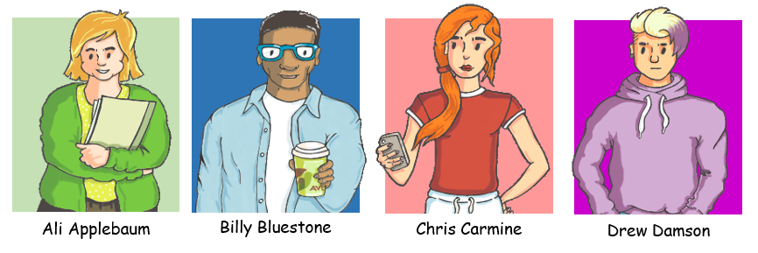
Your housemates 1
Your housemates…
Your housemates are all super stressed with exams right now. You don’t want to give it to the wrong person and stress them even more.
next >

Slide 12
Your housemates 2
Your housemates…
You’ve got to work out who it’s for.
Time to head onto campus to do some sleuthing!
What is copyright?
Go onto campus

Slide 13
Definition of copyright
You grab your phone and do a quick search for some basic info on copyright.
What is copyright?
Copyright is a type of ‘intellectual property right’ that is automatically given whenever someone creates an original creative work. It gives the creator the right to decide when and how their work is copied and shared with others.
back >

Slide 14
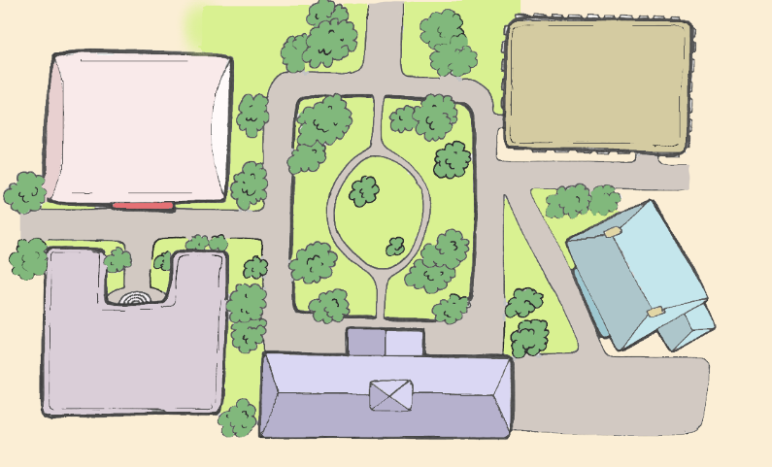
Campus map
STUDY CENTRE
COPYRIGHT HEIGHTS UNIVERSITY
Campus Map
SPORTS CENTRE
THE QUAD
CRUSTY CRUMPET CAFÉ
N
STUDENTS’ UNION
THE LIBRARY
Give the letter to a housemate
Click where you want to go

Slide 15
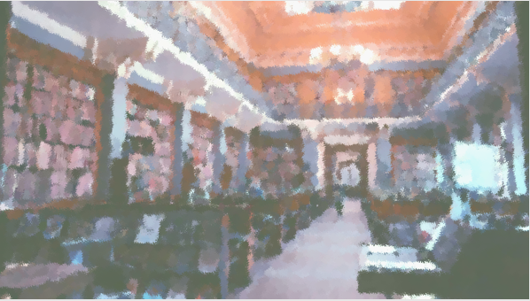
The Library foyer
The Library
You enter the library foyer. Well, this is nice. What will you do now?
Talk to the librarian
Look at the photocopier
Go back outside

Slide 16
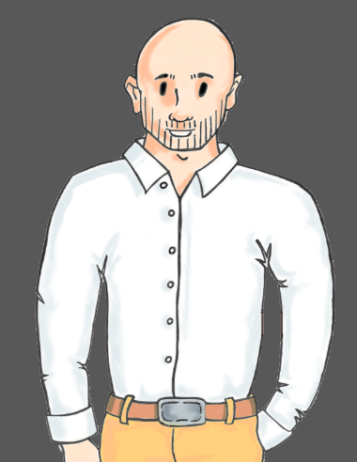
The Librarian
The Library
Hi! Welcome to the Library!
What can we help you with today?
Ask about the public domain
Ask about copyright exceptions
Ask about Creative Commons
Go back to library foyer

Slide 17
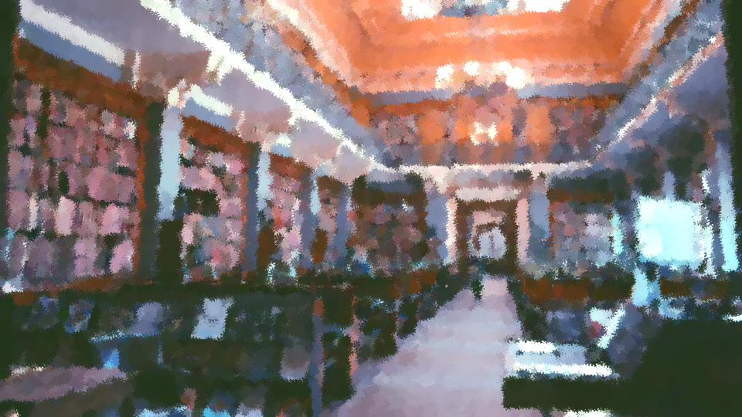
Public domain question 1
The Library
Great question! Copyright automatically protects new creative works, but it doesn’t last forever. It expires after a fixed time, usually 70 years after the original creator dies. Then the work enters the public domain, and anyone can use it for any purpose.
next >

Slide 18
Public domain question 2
The Library
The lovely library people at the University have a great website where you can find out more. I hope this helps!
Go to the library website
Ask another question
Go back to library foyer

Slide 19
Copyright exceptions question 1
The Library
Ooh! I love copyright exceptions!
Normally, you can’t use material that’s in copyright without permission from the copyright holder.
next >

Slide 20
Copyright exceptions question 2
The Library
However, copyright exceptions are special provisions in UK law.
They allow you to use material without permission in certain circumstances, such as for private study, provided your use meets certain conditions.
next >

Slide 21
Copyright exceptions question 3
The Library
Many exceptions have a ‘fair dealing’ requirement. This means your use must be fair to the copyright holder and not unduly affect their ability to profit from their work or share it in the way they want to.
next >

Slide 22
Copyright exceptions question 4
The Library
You can read more about this on the University library website. Let me know if you have any more questions!
Go to the library website
Ask another question
Go back to library foyer

Slide 23
Creative Commons question 1
The Library
People add Creative Commons licences to their work so they can share it openly with other people.
The licences allow people to reuse the work provided they follow certain conditions.
next >

Slide 24
Creative Commons question 2
The Library
The licences come in different ‘flavours’. Each one has slightly different conditions about what you can do with the work.
We did have a leaflet about it, but we seem to have run out. Sorry!
next >

Slide 25
Creative Commons question 3
The Library
You might want to look online for further information about them.
Have a great day!
Ask another question
Go back to library foyer

Slide 26
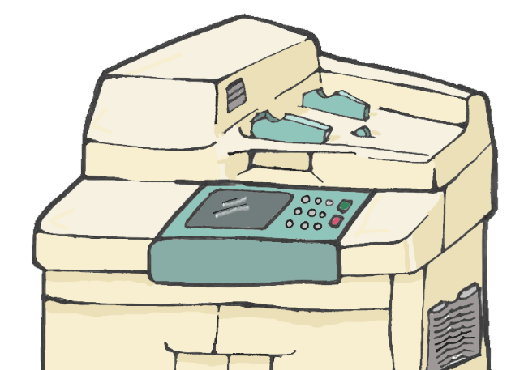
The photocopier
Here it is. And it’s not jammed for once.
Not sure what clues you’ll find here, though.
Wait. What does it say on the noticeboard?
Look at notice board
Go back to library foyer

Slide 27
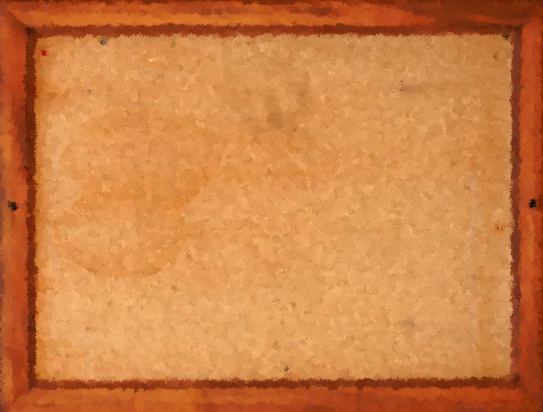
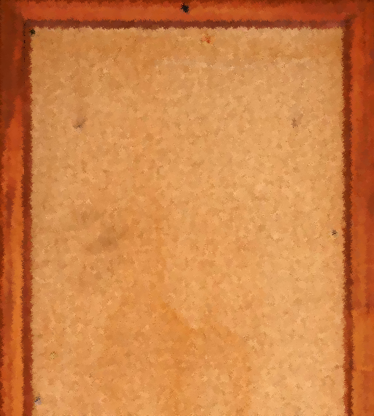
The photocopier notice board
© Copying limits
Under the UK copyright law Section 29 exception, you can copy a reasonable proportion (usually considered 1 chapter or 1 article) from any publication, provided the copy is for your own non-commercial private study or research. Your copying must be fair to the copyright holder.
The University also has a licence with the Copyright Licensing Agency, which covers copying of up to:
1 chapter from a book
2 articles from a journal issue OR an entire journal issue if it is devoted to a particular theme
10% of any publication.
All staff and students can make copies under this licence. It covers most books and journals printed in the UK.
~WAXING GIBBOUS~
Copyright Heights’ only hip-hopera band
Live at CHSU student bar
Featuring
Melody Screach - Soprano
Noah Tunes - Drums
Woody Windus – Bassoon
Drew Damson – Synth
Polly Tone – Fluegelhorn
WEDNESDAY NIGHTS FROM 8PM
W
G
Go back to library foyer

Slide 28
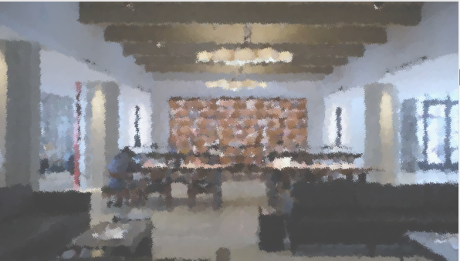
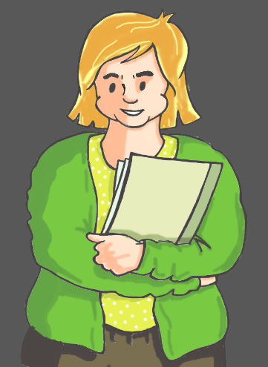
The Study Centre 1
The Study Centre
Hello housemate!
Revision! Ugh! Why is remembering stuff so hard?!
I’ve printed the most important articles and chapters I need so I can make notes with this awesome multicoloured pen! Look! Blue and green - in the same pen!
next >

Slide 29
The Study Centre 2
The Study Centre
Hey. Would you keep an eye on my stuff for a minute? I need to go make a call.
You can read my notes if you get bored.
You’re the best!
next >

Slide 30
The Study Centre 3
The Study Centre
What will you do?
Look at Ali’s notes
Check the leaflet display
Go back outside

Slide 31
Ali’s photocopied notes
Swashbuckler’s law of the sea: A textbook for aspiring buccaneers
Chapter 3
Law for the
incorrigibly curious
Chapter 12
Journal of Legal Stuff
Volume 22 Issue 3
Research article: The defendant stole a sick bird of prey. Was it illegal?
It’s various individual chapters and articles from different books and journals.
Done reading >

Slide 32
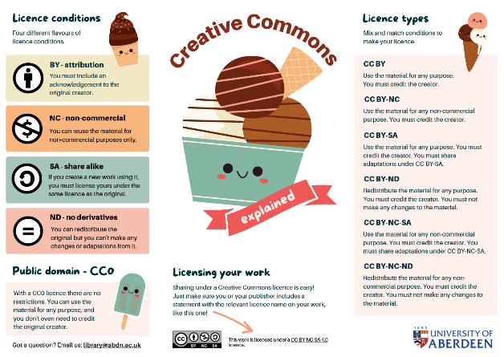
Creative Commons leaflet
Creative Commons?
Isn’t that something to do with copyright?
Done reading >

Slide 33
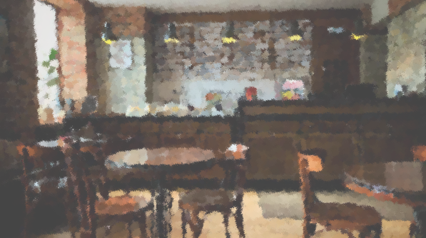
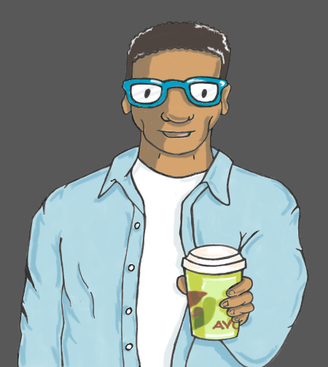
The Crusty Crumpet Café 1
Crusty Crumpet Café
How’s it going?
Check this out – they now do an avocado macchiato!
Did I tell you? I found this old documentary series that’s perfect for our class on Neolithic monuments!
next >

Slide 34
The Crusty Crumpet Café 2
Crusty Crumpet Café
I’ve uploaded all the episodes to our online course page so our whole lecture group can watch it. Now everyone can use it for their own study.
I’ve got the original DVDs here. Proper vintage tech! Want to have a look?
next >

Slide 35
The Crusty Crumpet Café 3
Crusty Crumpet Café
What will you do now?
Order an avocado macchiato
Go back outside

Slide 36
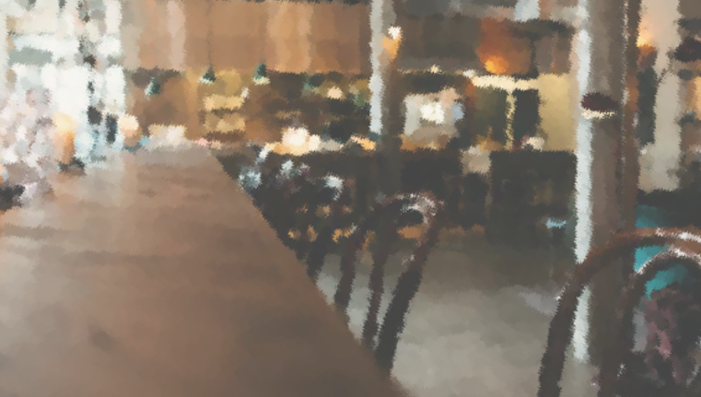
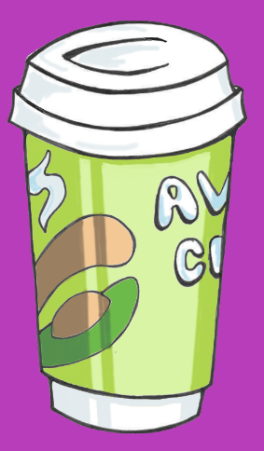
Ordering an avocado macchiato 1
You head over to the barista and order an avocado macchiato.
It’s as disgusting as it sounds.
Still, it wasn’t cheap, so you drink it with a grimace.
next >

Slide 37
Ordering an avocado macchiato 2
You feel a warm fuzzy feeling inside.
That’s probably not a good sign…
You decide you need to head outside for some fresh air.
Go back outside >

Slide 38
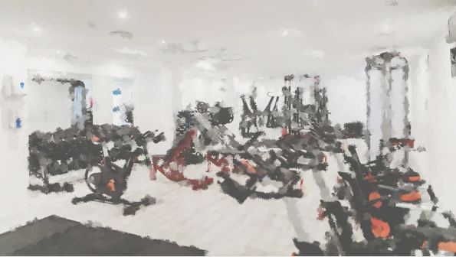
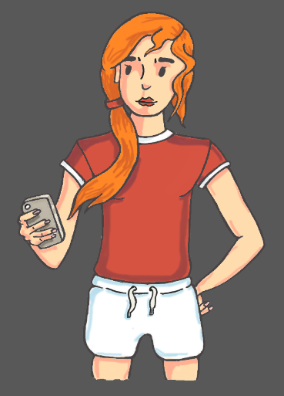
The Sports Centre 1
The Sports Centre
Hi! Just posting my workout tips to MyFace. Need that regular upload schedule to keep up my follower count!
My advice is all 100% science based. Each post includes a full scientific article to prove it’s all legit!
next >

Slide 39
The Sports Centre 2
The Sports Centre
What do you want to do now?
Look at Chris’ MyFace channel
Go back outside

Slide 40
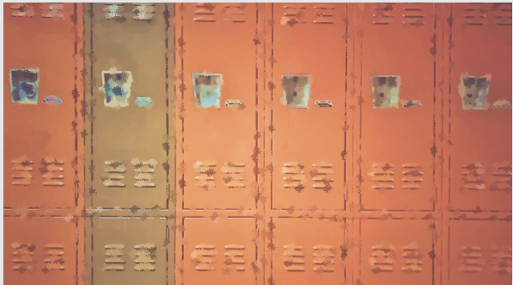
Chris’s social media pages
There’s Chris’s post and an uploaded copy of the full text of a scientific article. Interesting, if you’re into that kind of thing.
Peer-reviewed pump
Don’t believe me?
Here’s the science!
OPEN ACCESS
Influence of daily beer or ethanol consumption on physical fitness in response to a high-intensity interval training program. The BEER-HIIT study
Cristina Molina-Hidalgo et al.
Journal of the International Society of Sports Nutrition (2020)
Licensed under a CC BY 4.0 international licence.
High-intensity interval training (HIIT) is an effective approach to improve physical fitness, but consuming beer, which is a regular practice in many physically active individuals…
with CHRIS CARMINE
Working out sober
= less pain
Believe it or not, people who work out sober suffer from fewer injuries and less post-workout soreness.
That’s why I never add sherry to my pre-workout stack. And you shouldn’t either.
Done reading >

Slide 41
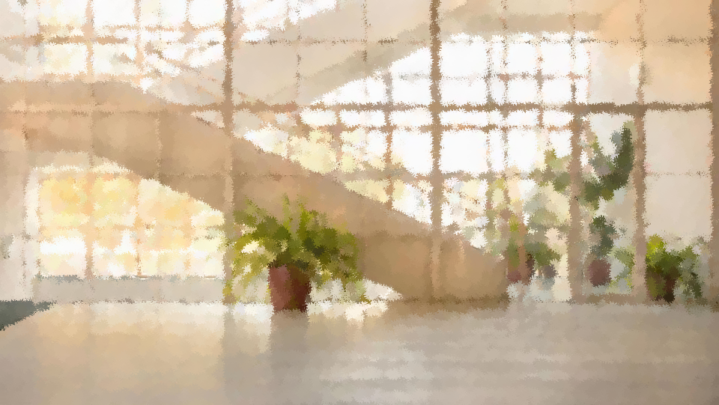
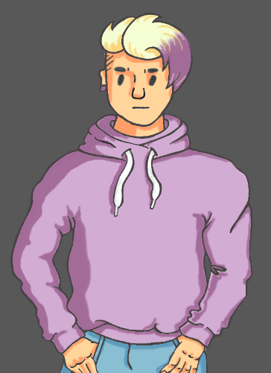
The Students’ Union 1
The Students’ Union
Hey. Can’t stop for too long. Setting up for our gig.
It’s the first one for our new hip-hop opera fusion band, Waxing Gibbous.
next >

Slide 42
The Students’ Union 2
The Students’ Union
We’re looking to make it big on the hip-hopera scene.
Promotion’s gonna be key. Check out our merch!
next >

Slide 43
The Students’ Union 3
The Students’ Union
What will you do next?
Look at Drew’s promotional merchandise
Go back outside

Slide 44
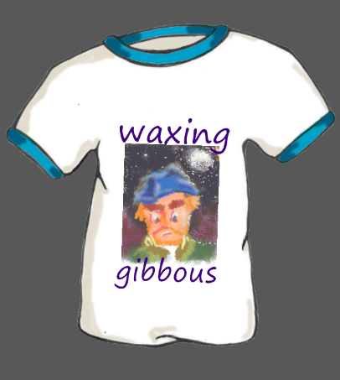
Drew’s promotional merchandise
Do people buy this stuff?
You’re pretty sure Drew didn’t do the artwork, but the artist isn’t named or credited anywhere.
You hope the band’s music is better than their branding.
Go somewhere else >

Slide 45
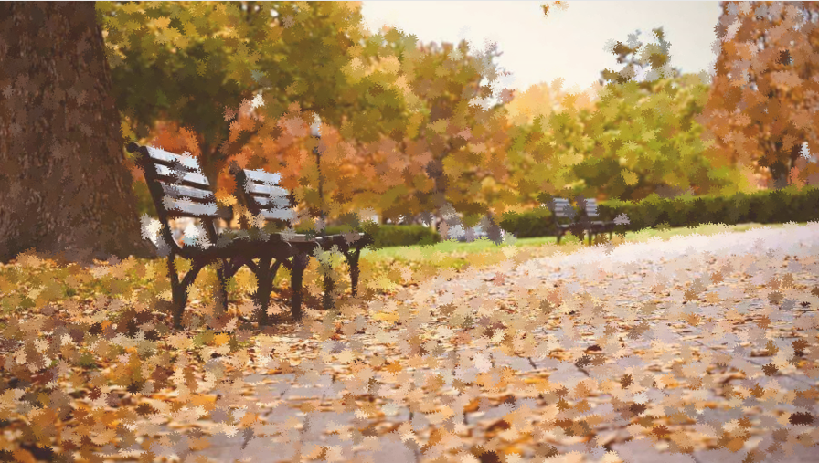
The Quad 1
The Quad
Ah! The leafy central quad.
This is very pleasant.
You decide to have a sit down.
next >

Slide 46
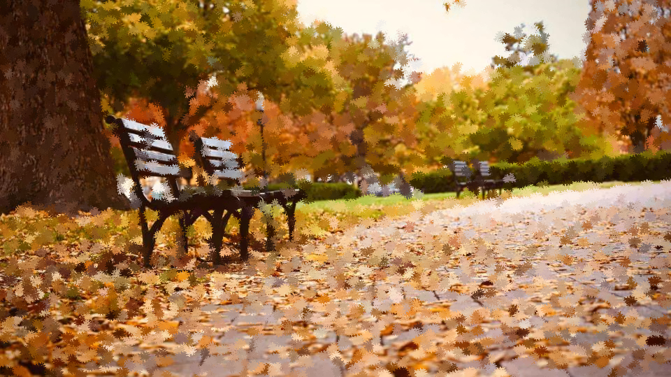
The Quad 2
The Quad
Ugh! The bench is still wet.
And some untidy so-and-so has left a newspaper behind.
next >

Slide 47
The Quad 3
The Quad
Well, you can’t sit here all day. What will you do next?
Look at the newspaper
Check your phone
Go somewhere else

Slide 48
The newspaper
Hmm. A fishing newspaper. Fascinating.
Done reading >

Slide 49
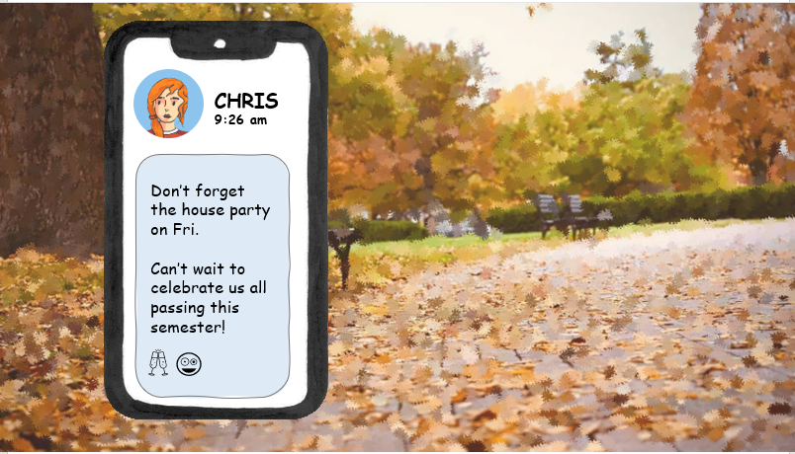
Text message from Chris
A reminder from Chris.
But you’ll need to solve this copyright mystery to make sure everyone has a happy end to the semester!
Do something else >

Slide 50
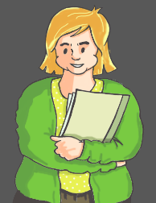
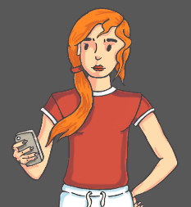
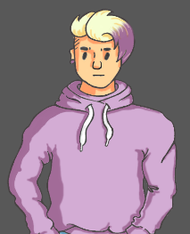
Choosing a housemate
Ali
Billy
Have you worked out who the letter is for?
Pick the housemate you think has most likely infringed copyright.
Chris
Drew
Go back and do more sleuthing >

Slide 51
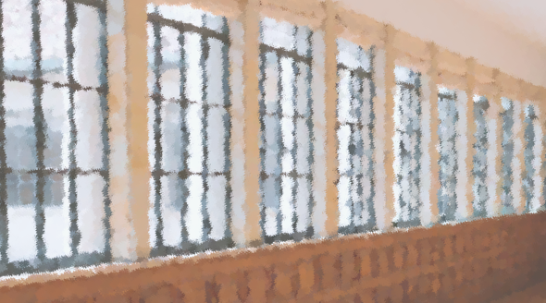
Ali outcome 1
You rush back to the study centre. Hopefully, you can catch Ali before her next exam.
In your haste you bump into someone carrying a stack of papers who’s clearly in a hurry too...
next >

Slide 52
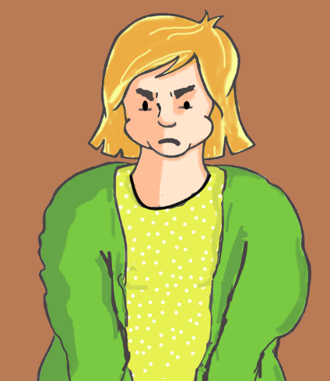
Ali outcome 2
Hey! Watch it! Look what you’ve done!
Ali glares at you and begins picking up her scattered papers.
next >

Slide 53
Ali outcome 3
You try to help, while explaining that you don’t think Ali should have copied these pages in the first place.
next >

Slide 54
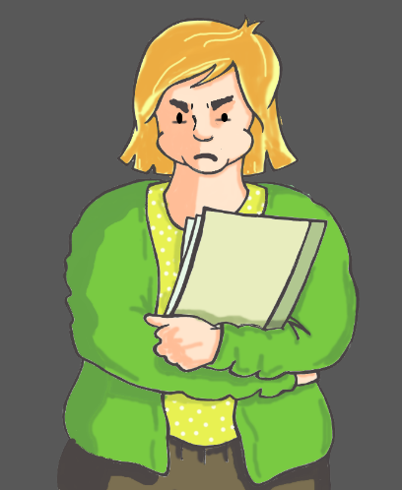
Ali outcome 4
What do you mean?
You hand Ali the copyright letter.
Ali looks at you and sighs.
next >

Slide 55
Ali outcome 5
These copies are for my own private study! Copying one chapter from a book or one article from a journal issue for my personal use is considered fair dealing! Take your letter and stop bothering me. I have an exam to get to!
next >

Slide 56
Ali outcome 6
Well, that didn’t go too well.
What are you going to do now?
Go back outside

Slide 57
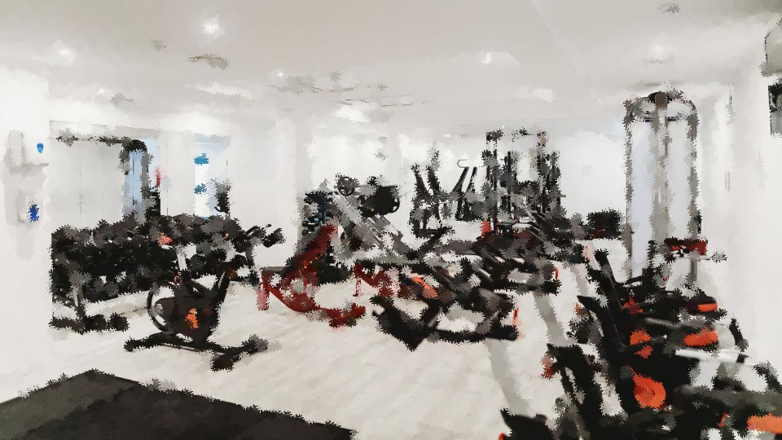
Chris outcome 1
You head back to the gym.
You spot a familiar figure on the elliptical trainer and hurry over.
next >

Slide 58
Chris outcome 2
Chris removes her ear buds and closes an app on her phone.
Phew… This had better be important… I was just about to… record a personal best… for most ellipses... in 10 minutes…
next >

Slide 59
Chris outcome 3
You apologise for interrupting and show Chris the copyright letter.
You explain how you think Chris’ MyFace might be infringing copyright by publicly posting the full text of scientific articles.
next >

Slide 60
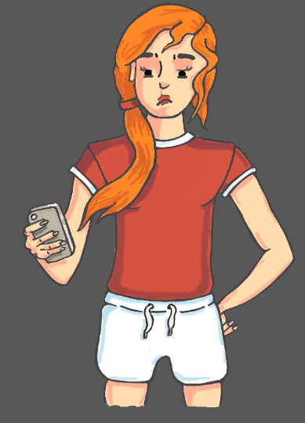
Chris outcome 4
Chris groans.
Didn’t you see? Those articles have CC BY licences. They’re specifically designed to be shared openly. You just need to credit the original authors. And now I’m not going to get that personal best today!
next >

Slide 61
Chris outcome 5
She grabs her water bottle and storms off towards the changing rooms.
Well, that could have gone better. What will you do now?
Go back outside

Slide 62
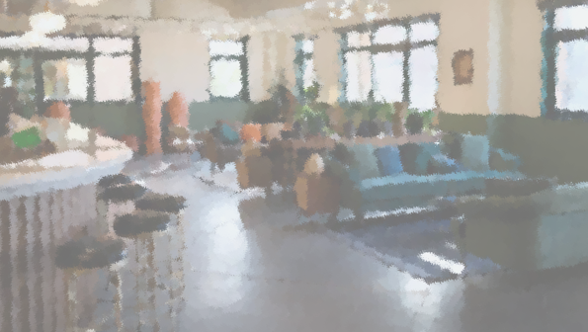
Drew outcome 1
You go back to the students’ union.
As you head towards the band room, you spot Drew talking with another student in the bar. They’re looking at one of Drew’s t-shirts. Drew looks up.
Hey, housemate. S’up?
next >

Slide 63
Drew outcome 2
You politely explain that you believe Drew’s merchandise infringes copyright because it uses someone else’s artwork without their permission or crediting them.
The other student mumbles an awkward apology and leaves.
next >

Slide 64
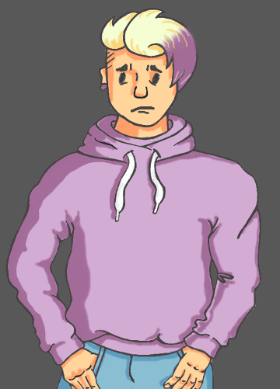
Drew outcome 3
Drew sighs and rolls their eyes.
Chill! The artist has been dead for a century. Their work’s public domain now. Free for me, you or anyone to use, even if you don’t credit them.
next >

Slide 65
Drew outcome 4
And thanks a lot! You’ve just lost me my first sale!
Drew picks up their merch and disappears into the practice room, slamming the door behind them.
next >

Slide 66
Drew outcome 5
You can’t believe someone was actually going to buy one of Drew’s t-shirts. But still, Drew’s really not happy with you.
What are you going to do now?
Go back outside

Slide 67
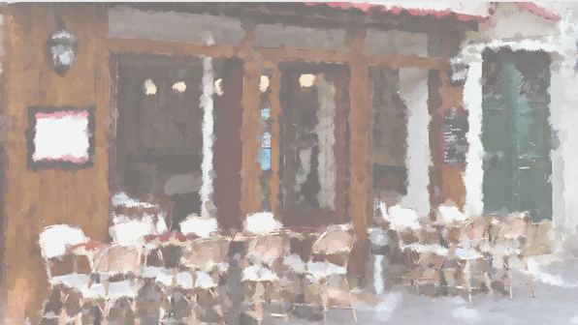
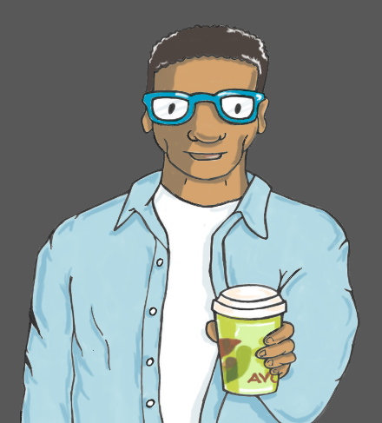
Billy outcome 1
You walk back towards the café, but you can’t see Billy. You’re about to reach for your phone when you hear someone call your name.
A figure appears with a takeaway mug of hot greenish liquid.
next >

Slide 68
Billy outcome 2
Alright?! Back for another avocado macchiato? I told you they were good!
next >

Slide 69
Billy outcome 3
You explain it’s actually Billy you’re here to see.
You show him the copyright letter and explain that you think it’s for him because of the video content he’s been sharing on his course site.
next >

Slide 70
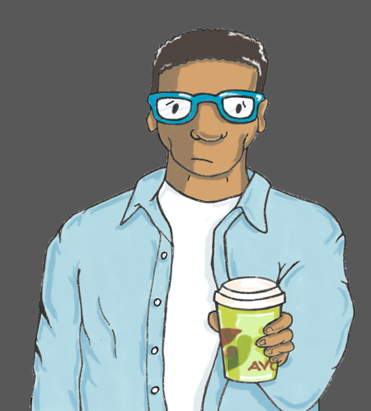
Billy outcome 4
Billy looks concerned.
I didn’t think of that. I thought it’d be fine because it’s for educational use. What am I going to do now?!
next >

Slide 71
Billy outcome 5
You try to be reassuring
Perhaps if Billy speaks to his lecturer, they can sort it out.
You both head towards the humanities department.
next >

Slide 72
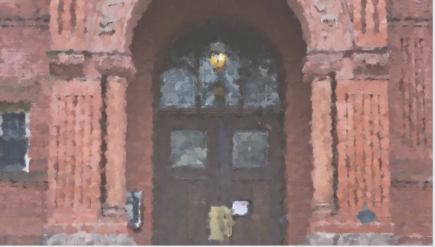
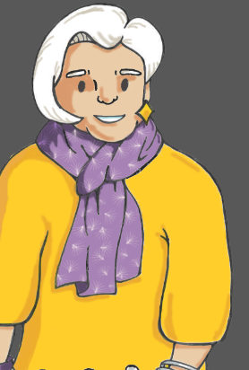
Meeting the professor 1
As you approach the building, someone calls out to you.
Professor Khatoon!
Billy! Did you get my letter? I’ve been trying to get hold of you for the longest time.
next >

Slide 73
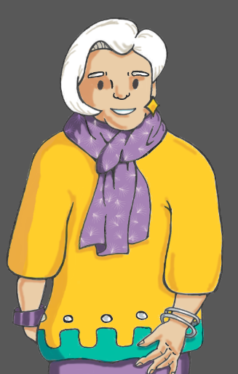
Meeting the professor 2
You very helpfully uploaded that Neolithic monuments documentary series, but I’m afraid you’ll need to take it down.
The amount you’ve copied doesn’t count as fair dealing under copyright law. And we don’t have a licence to copy it either.
next >

Slide 74
Meeting the professor 3
But I’ve spoken to the Library, and they’ve bought us access to the full series. It comes with a licence so that anyone in the University can watch it.
next >

Slide 75
Meeting the professor 4
Sorry, professor. I just didn’t think. I’ll get that sorted asap.
By the way, why did you send me a letter? You usually email us. That’s really old school!
next >

Slide 76
Meeting the professor 5
Well, I tried emailing you, but you never replied. Perhaps it ended up in your spam.
Looking back, putting ‘Illicit videos online – act now’ as the subject line probably wasn’t the best idea.
next >

Slide 77
Meeting the professor 6
I really shouldn’t write emails when my brain isn’t adequately caffeinated.
But ever since I tried that green concoction they started serving in the café, even the thought of coffee sends me running straight to the bathroom…
next >

Slide 78
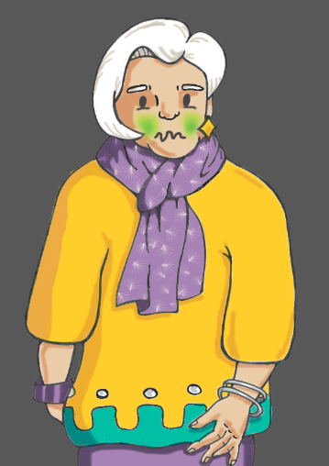
Meeting the professor 7
She catches sight of Billy’s takeaway cup and stops suddenly. You’re not sure what looks greener – Billy’s drink or the professor’s face.
Oh goodness! Do excuse me.
next >

Slide 79
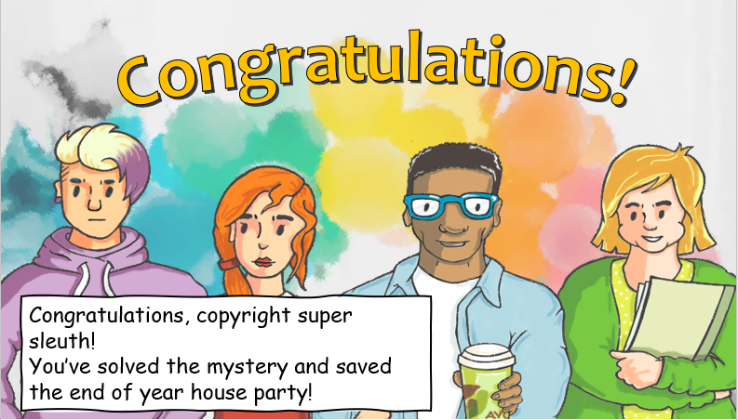
End of game
Game solution explanation
Finish

Slide 80
Acknowledgements
Acknowledgments
Created by the University of Aberdeen Digital Skills Team and adapted by Kate Woods on behalf of Manchester Met University with kind permission from Aberdeen University.
Music by Yevhen Lokhmatov, free background music: www.lokhmatovmusic.com
Click anywhere or press ‘ESC’, or close this window to exit the game.
Notes:
Include Jazz by ‘Wavemaster’ from Pixabay

